Slide 1

Department of Computer Science Gujarat University
5 Year Integrated M.Sc.(Computer Science)
Semester - IV
Department of Computer Science
Website
Presented By:
Janvi Chauhan ( 03 )
Ansh Yadav ( 36 )
Under the Guidance of :
Dr. Bhumika Shah

Slide 2
Table of Content
Project Profile
Software analysis
Requirements
Use case
Activity Diagram
Sequence Diagram
State Diagram
Software design
Class diagram
Data dictionary
Decision Table
Screenshot
Conclusion
Future Work
References

Slide 3
Project Profile
TITLE | DESCRIPTION
Project Title | Department of Computer Science Website
Aim of the Project | Provide detailed information about Department computer science
Project duration | 6 month
Team size | 2 Member
Tools used | VS code, XAMPP Server, Github
Technologies used | php, html, css, tailwindcss, JavaScript, mysql, Jquery, bootstrap
Minimum software and hardware requirements | Any browser compatible with HTML, CSS, JavaScript
Guide | Dr.Bhumika Shah

Slide 4
Project Profile
Department Website for “Maharishi Pingla, School of Advance Computing and Information Technology ”.
It is defined to create easy way of communication between the department and it’s students.
The project's objective is to render the department's general material, such as course descriptions like course etc faculty profiles, event planning, and a history of previous events and alumni details easily accessible to all.

Slide 5
SYSTEM ANALYSIS

Slide 6
Requirements
Requirements of Admin
Login
Manage Events
Manage News letter
Manages Syllabus
Manages Course and Syllabus
Manages Feedback
Manages Awards
Manages Papers
Mananges Results
Manages Circular

Slide 7
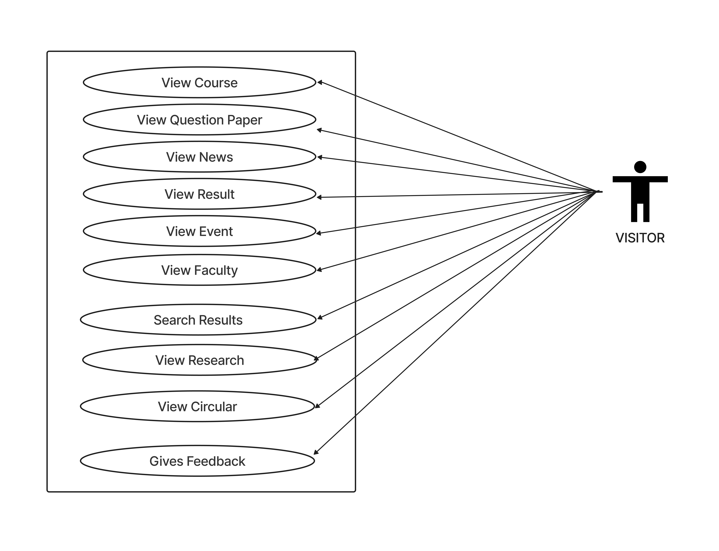
Use Case

Slide 8
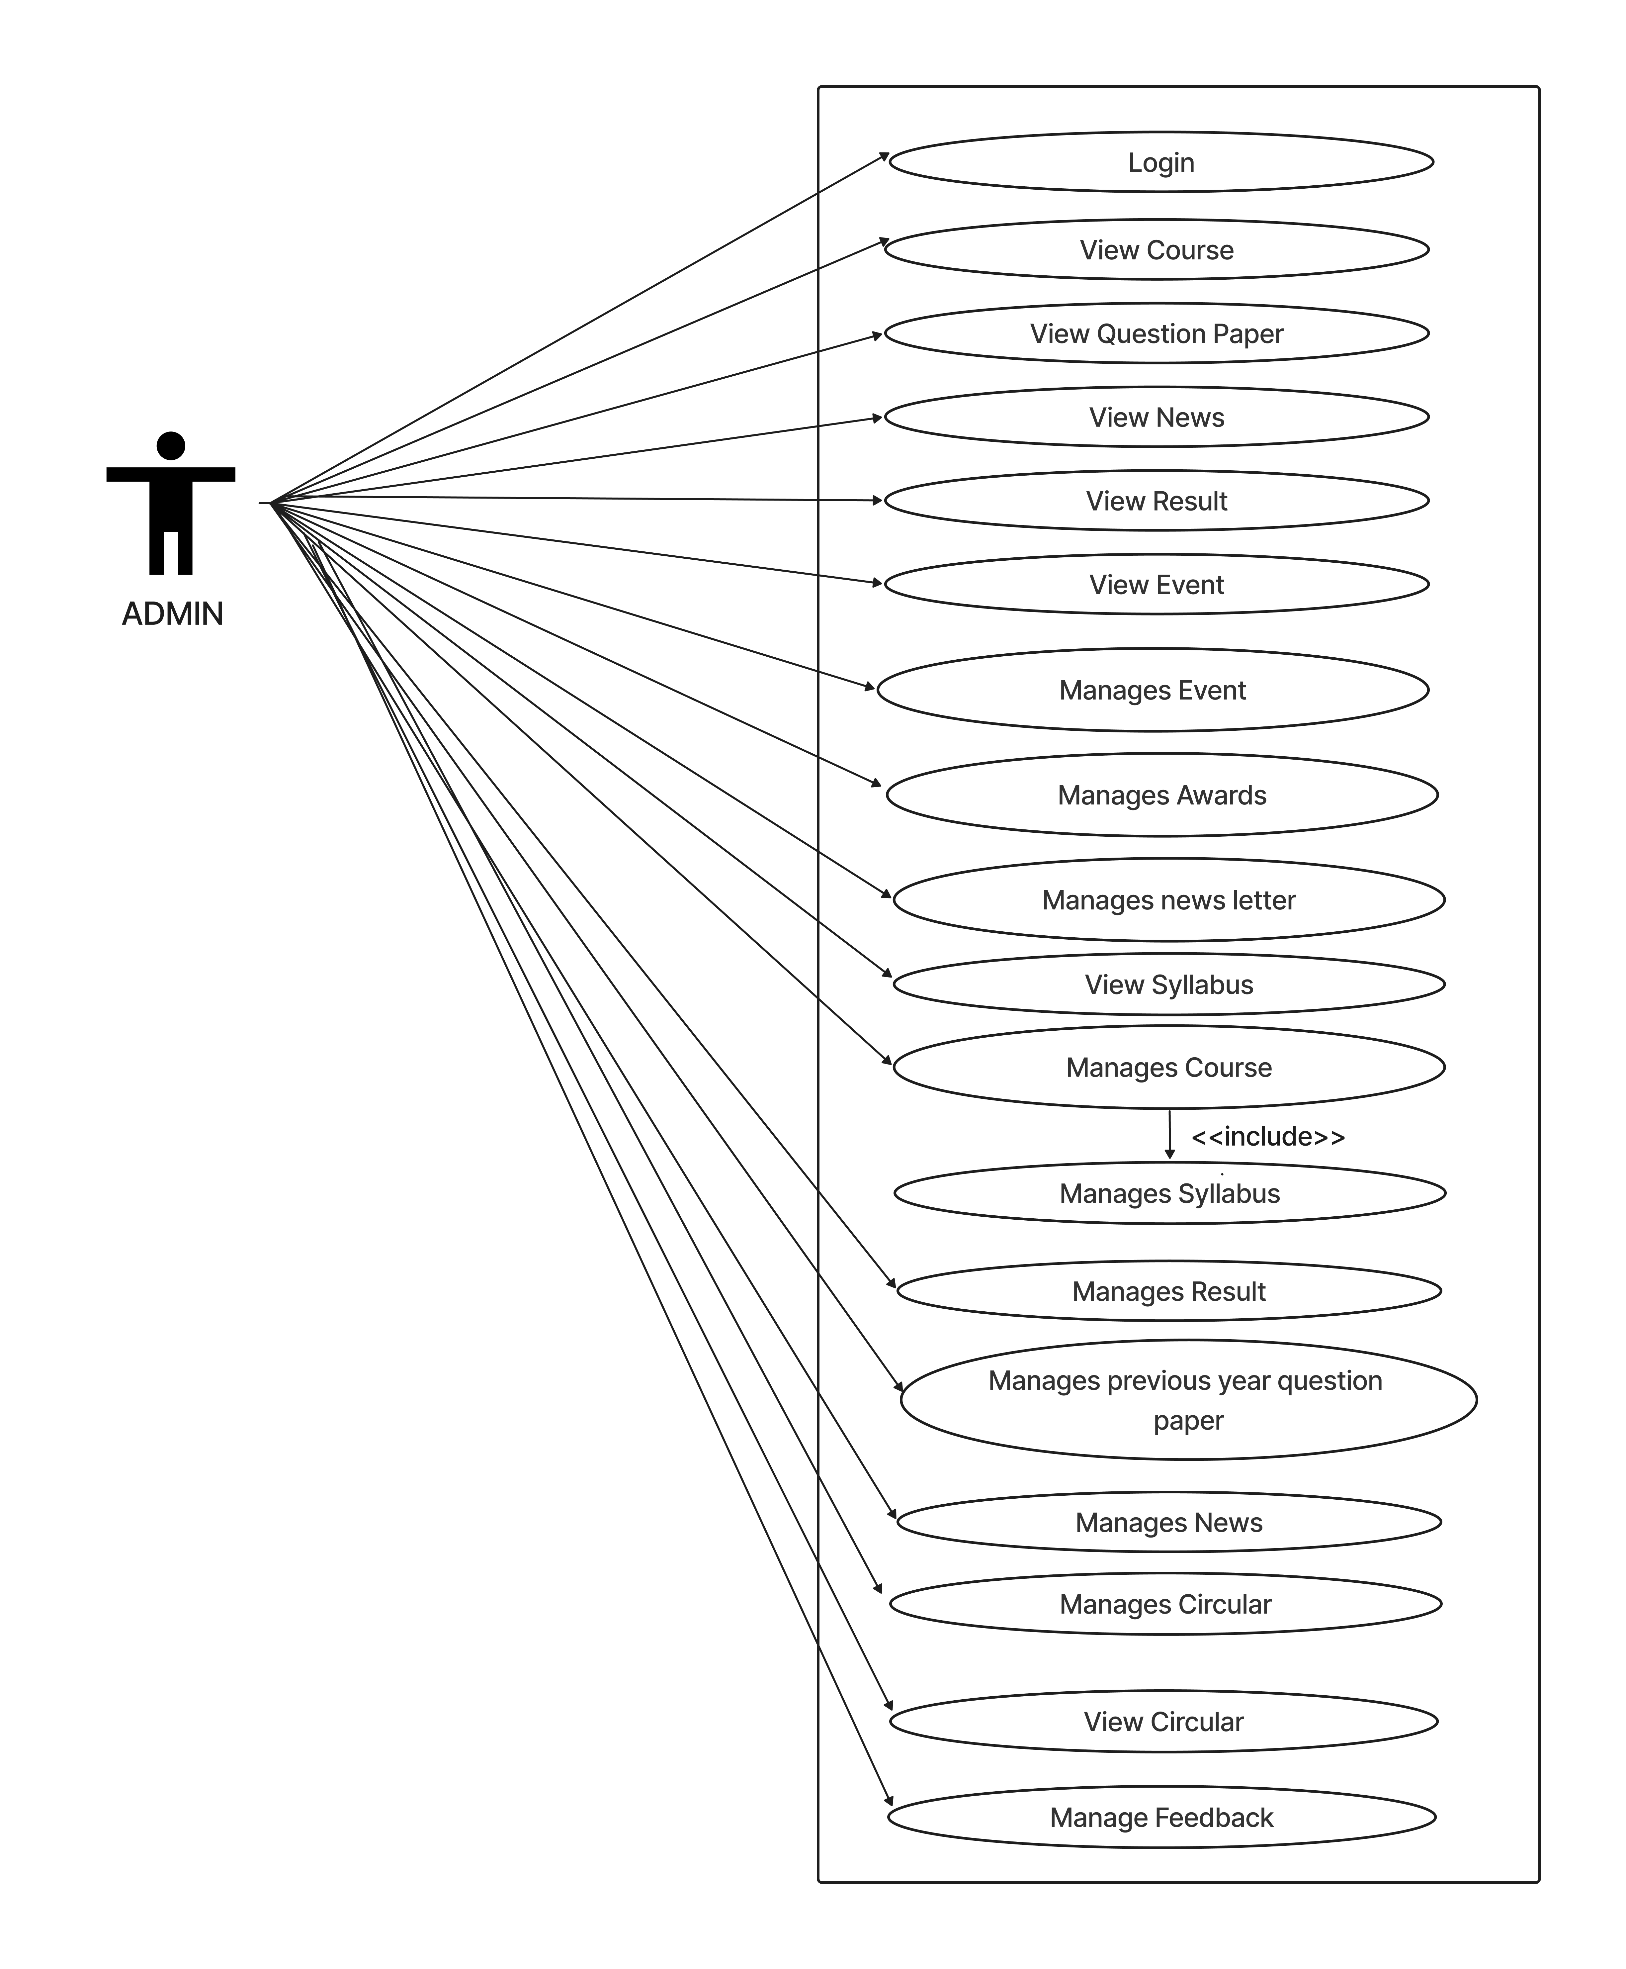
Use Case

Slide 9
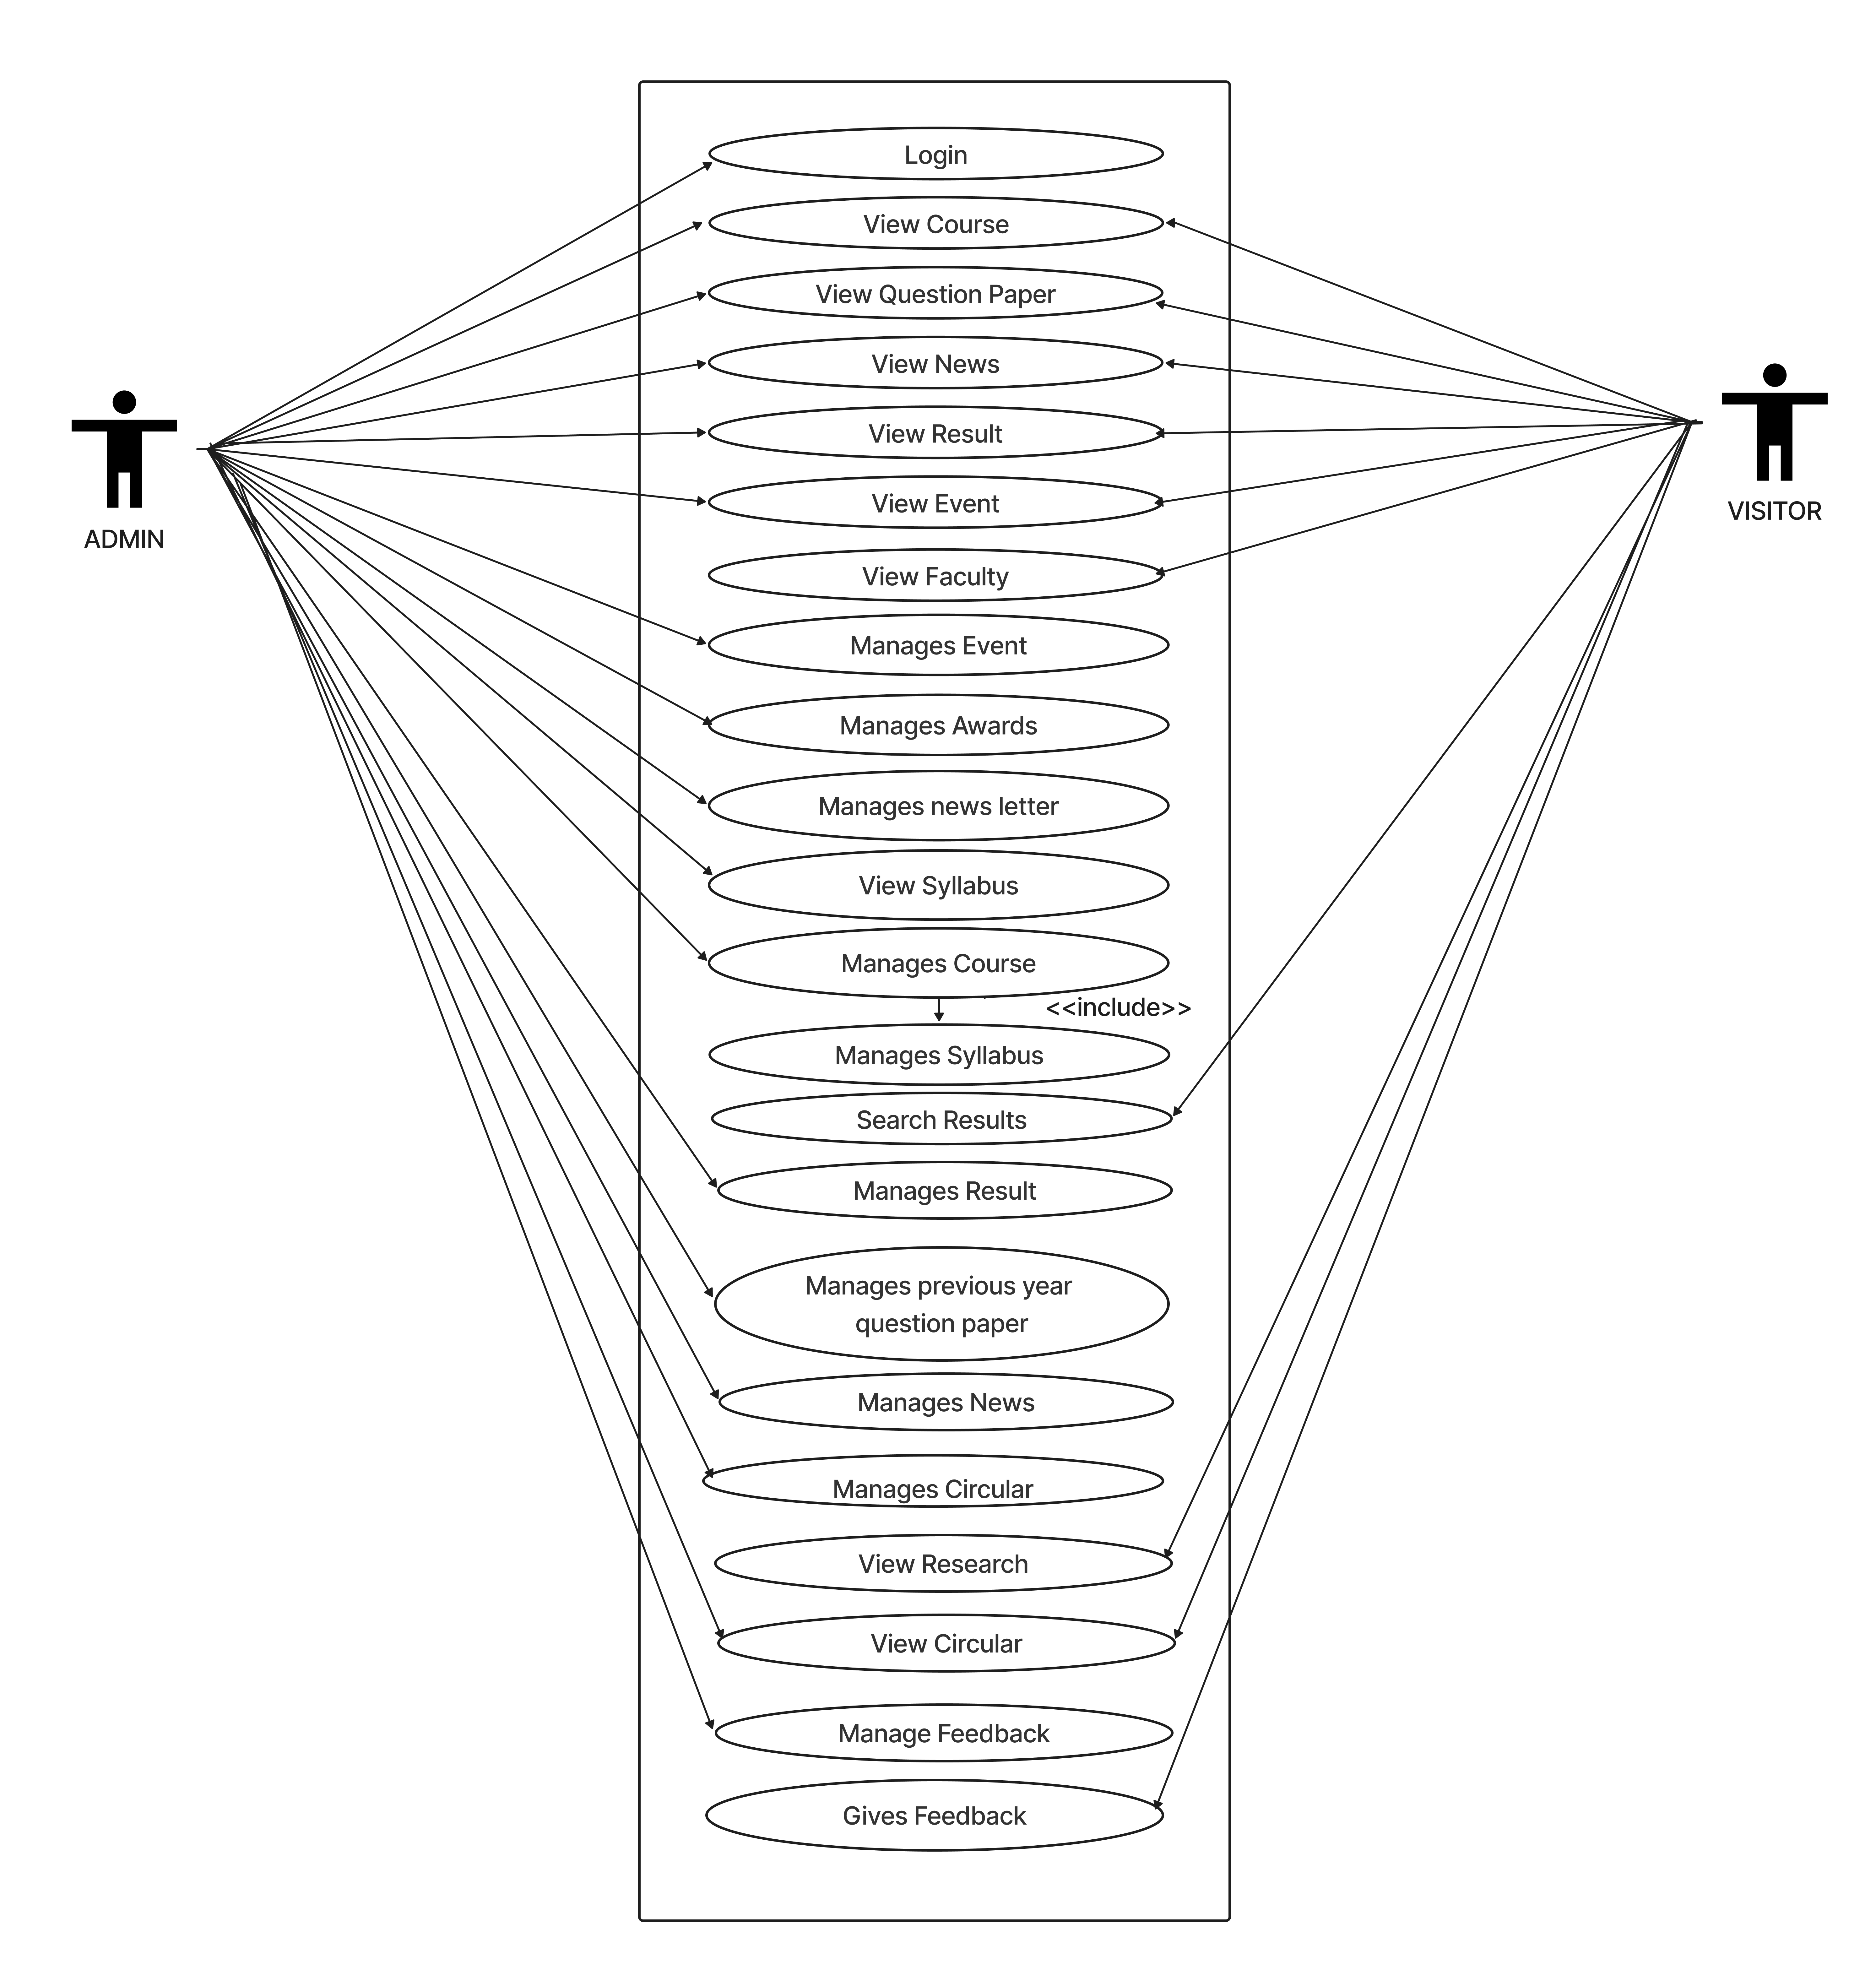
Use case

Slide 10
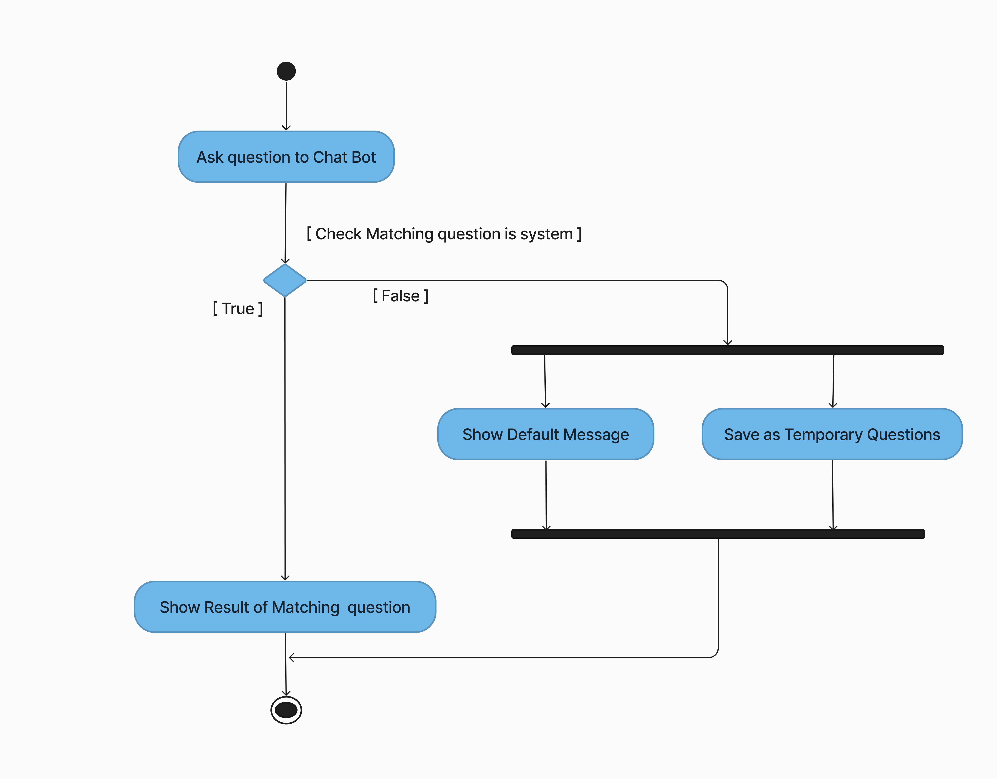
Acitivity diagram of Chat Bot

Slide 11
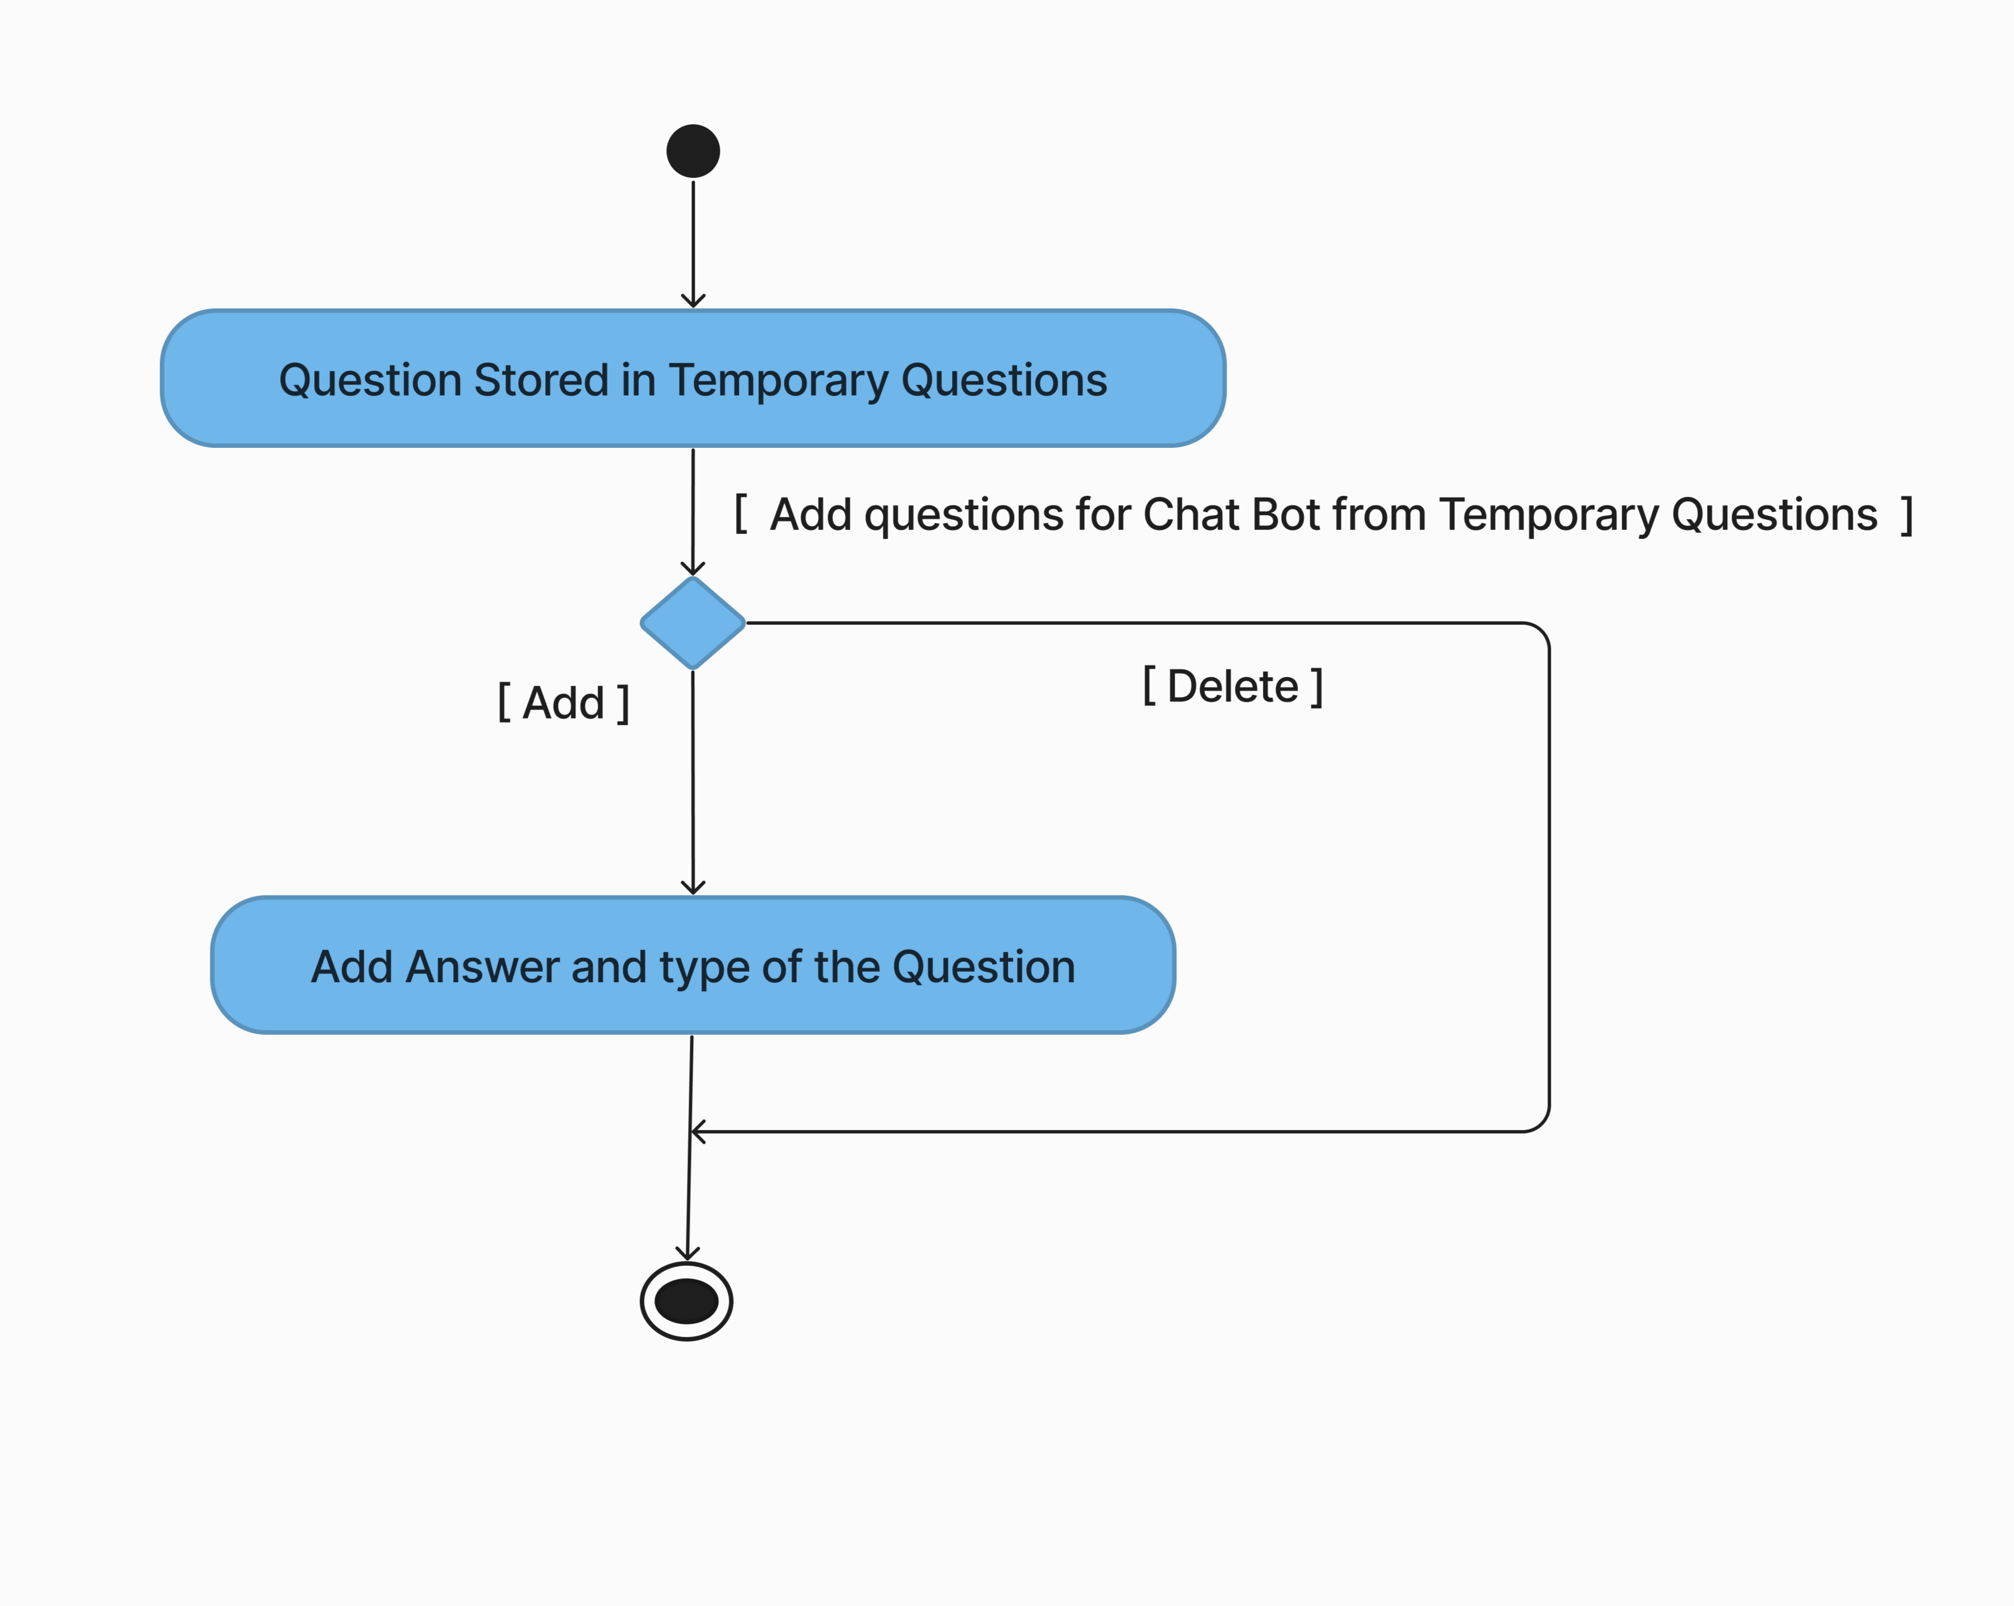
Activity diagram to Add Quesitons in chat bot by admin

Slide 12
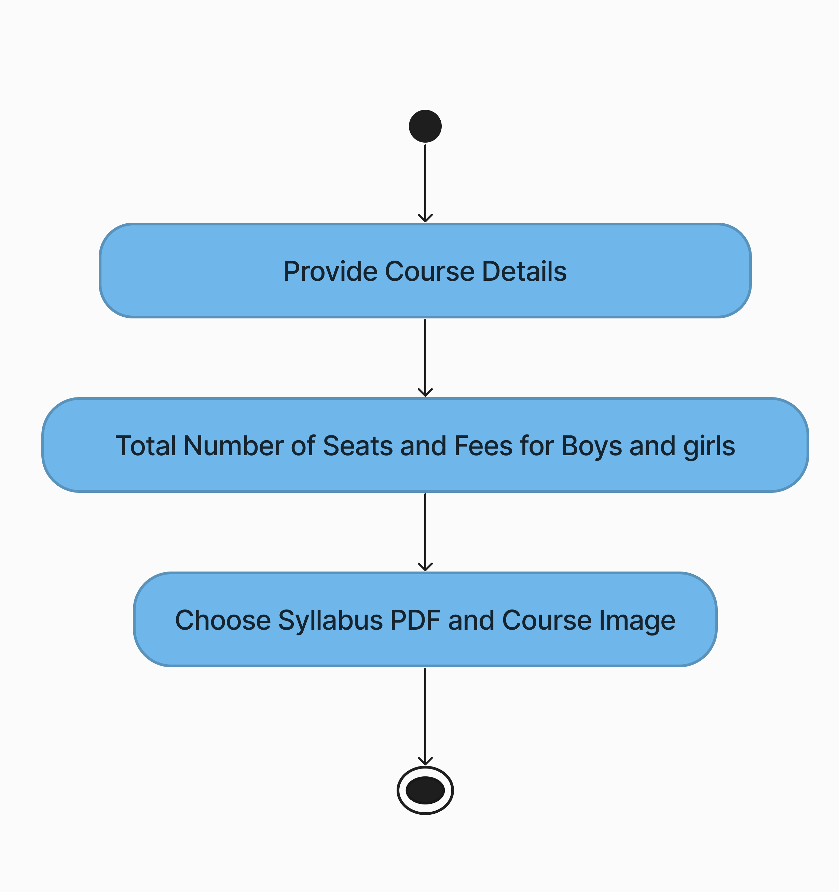
Activity diagram of Course

Slide 13
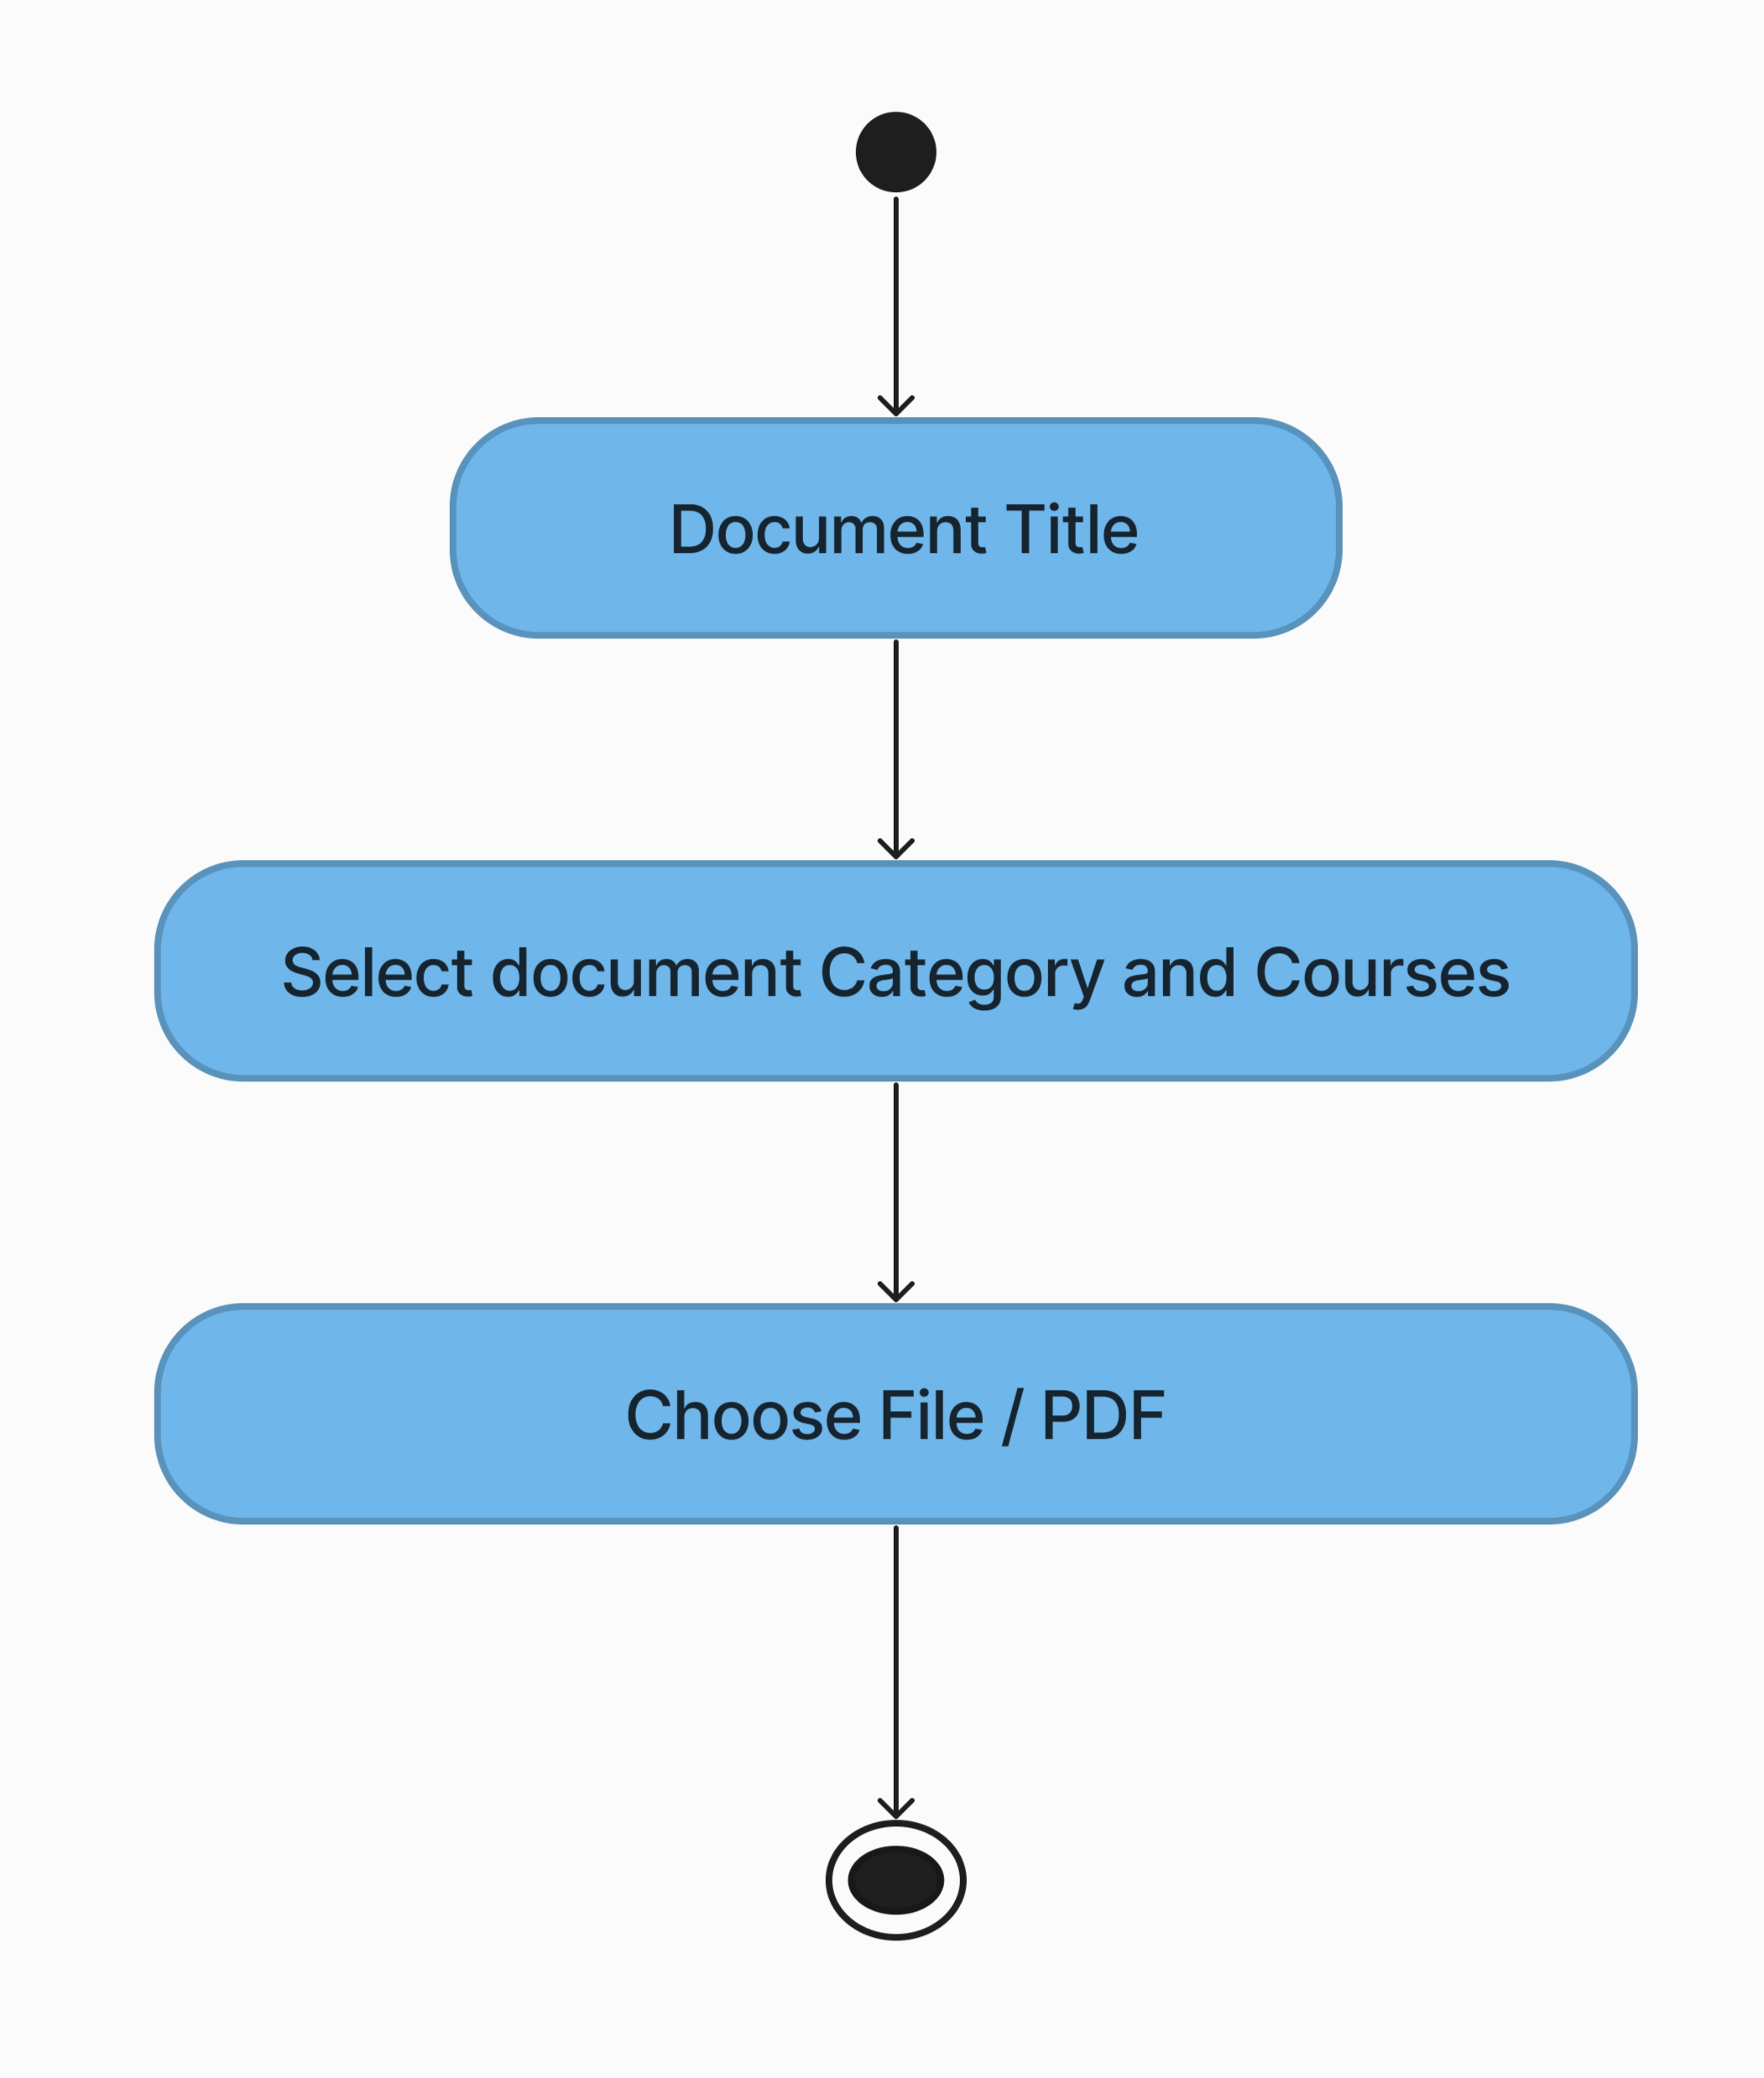
Activity diagram of Document

Slide 14
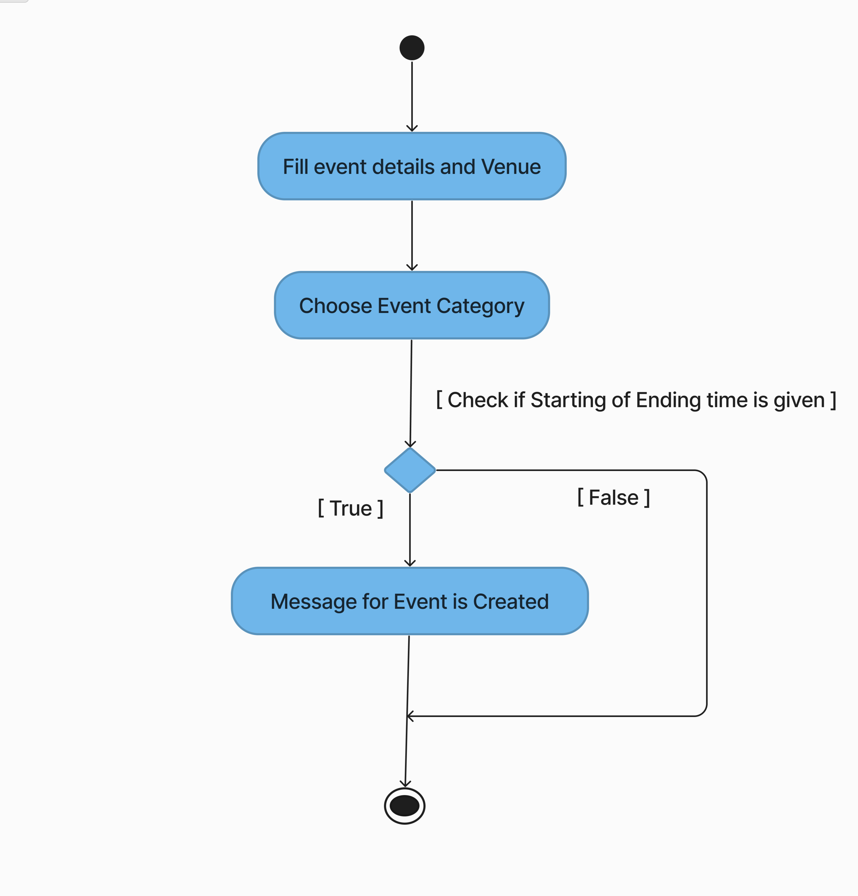
Activity diagram of Events

Slide 15
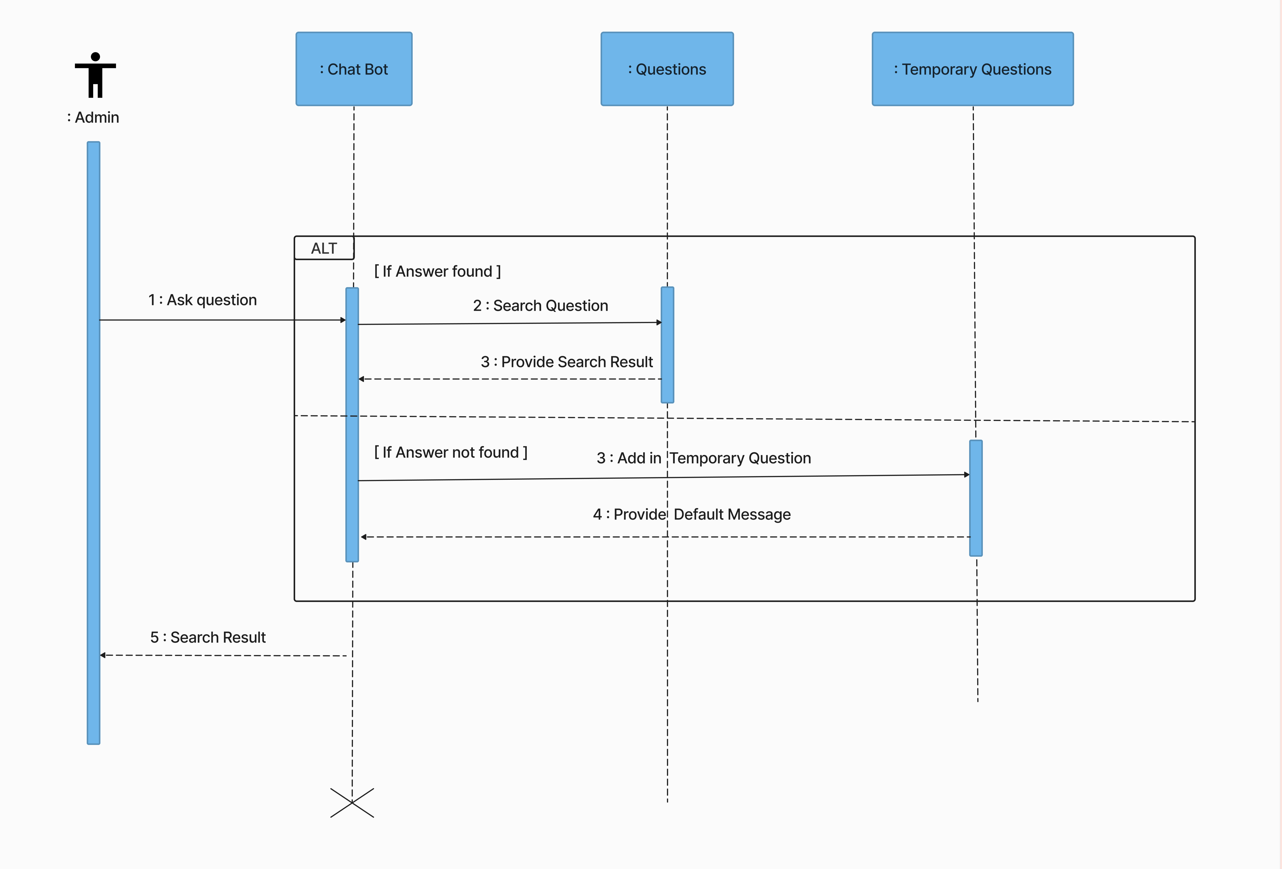
Sequence Diagram for Chat Bot

Slide 16
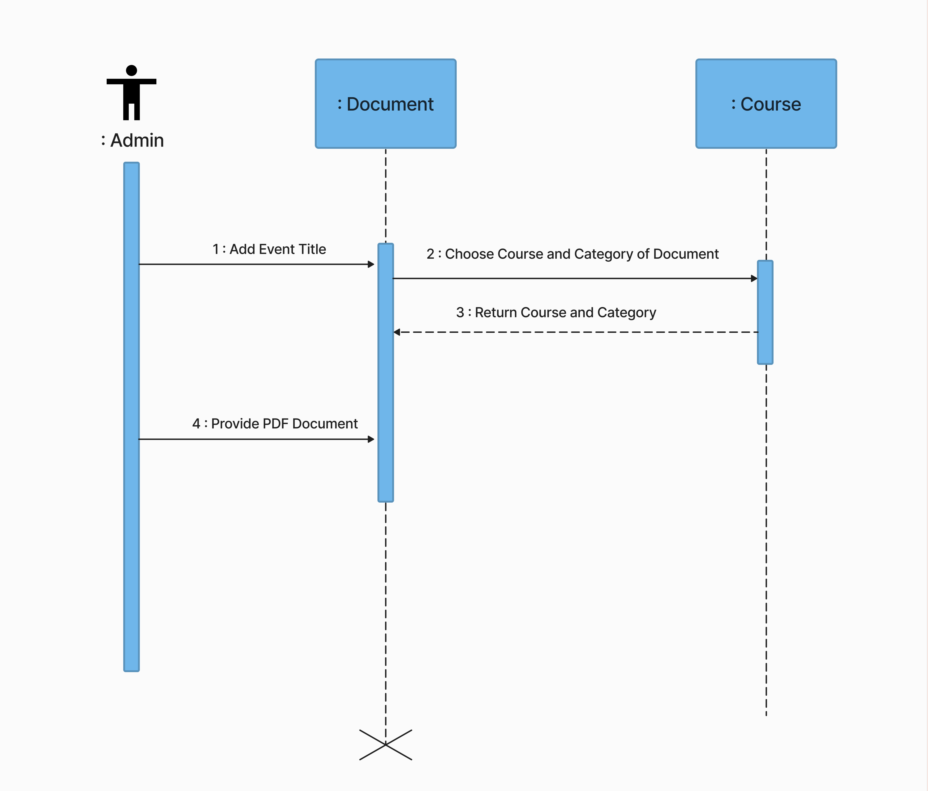
Sequence Diagram for Documents

Slide 17
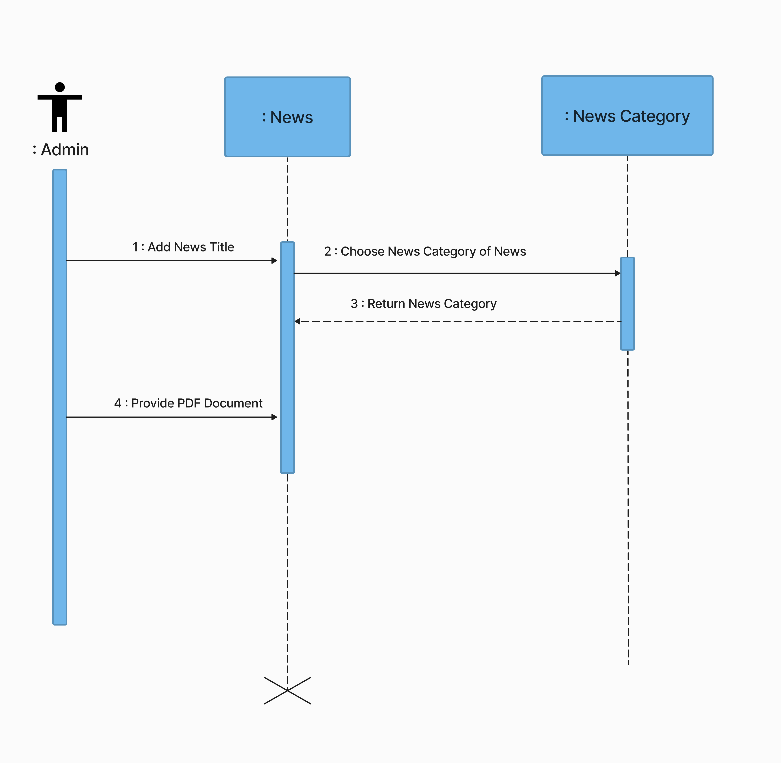
Sequence Diagram for News

Slide 18
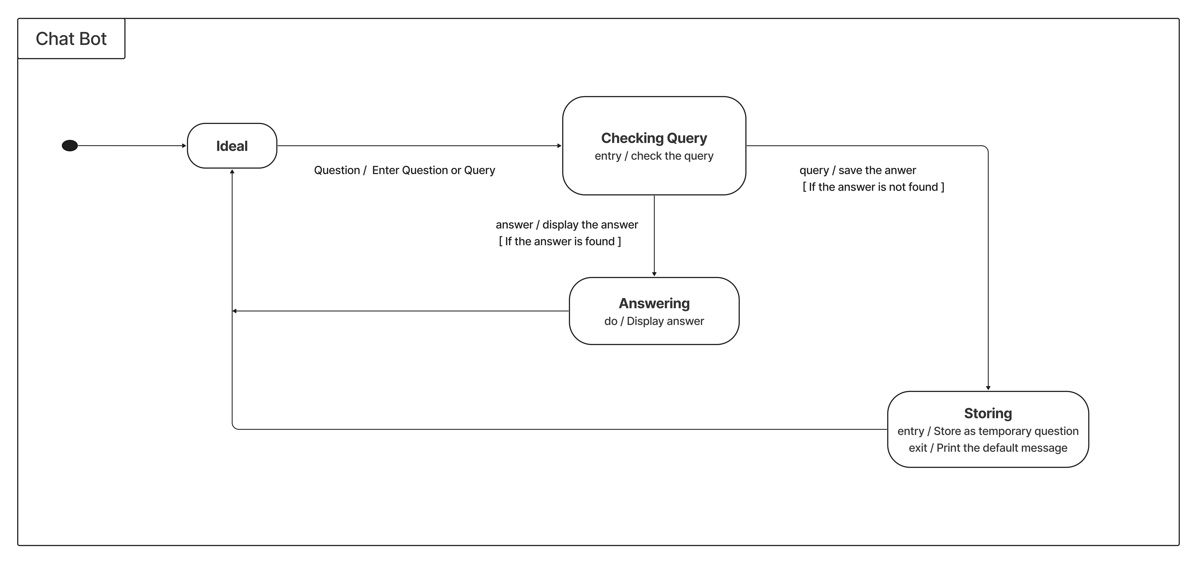
State Diagram for Chat Bot

Slide 19
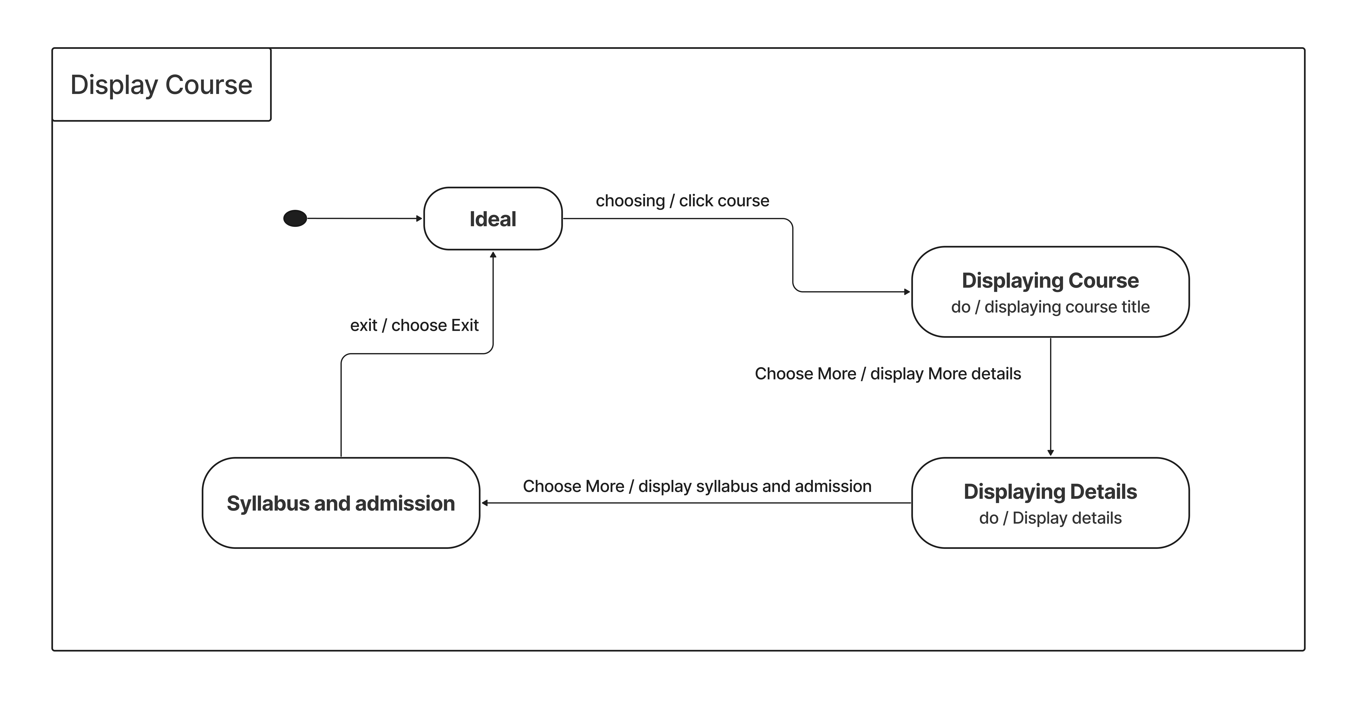
State Diagram for Course

Slide 20
SOFTWARE DESIGN

Slide 21
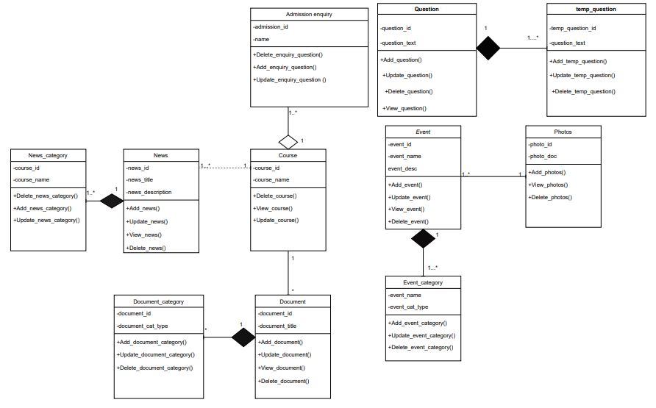
Class Diagram

Slide 22
User Table
SERIAL NO | FIELD NAME | TYPE | SIZE | CONSTRAINTS | SAMPLE DATA
1 | user_id | INT | 5 | Primary key | 123
2 | user_name | VARCHAR | 10 |  | kapil
4 | user_email | VARCHAR | 50 |  | kapil@gmail.com
5 | user_password | VARCHAR | 25 |  | kapil123@45

Slide 23
Achievements Table
SERIAL NO | FIELD NAME | TYPE | SIZE | CONSTRAINTS | SAMPLE DATA
1 | awd_id | INT | 3 | Primary key | 1
2 | awd_winner | VARCHAR | 255 |  | Viraj Nayar
3 | awd_name | VARCHAR | 255 |  | nixi fellowships
4 | awd_place | VARCHAR | 255 |  | For the most...
5 | awd_time | DATE |  |  | 2014-02-12

Slide 24
Event Table
SERIAL NO | FIELD NAME | TYPE | SIZE | CONSTRAINTS | SAMPLE DATA
1 | event_id | INT | 3 | Primary key | 1
2 | event_title | VARCHAR | 100 |  | Bhuvan Portal
3 | event_description | TEXT |  |  | Lecture of Bhuvan portal
4 | event_venue | VARCHAR | 100 |  | Senate hall, gujarat uni...
5 | event_start | DATETIME |  |  | 08-01-2023 02:30:00
6 | event_end | DATETIME |  |  | 08-01-2023 02:30:00
8 | event_category_id | INT | 2 | Foregin key, Not Null | 11

Slide 25
Photos Table
Event Category Table
SERIAL NO | FIELD NAME | TYPE | SIZE | CONSTRAINTS | SAMPLE DATA
1 | event_category_id | INT | 2 | Primary Key | 1
2 | event_category_type | VARCHAR | 30 |  | Technical
SERIAL NO | FIELD NAME | TYPE | SIZE | CONSTRAINTS | SAMPLE DATA
1 | photo_id | INT | 2 | Primary Key | 2
2 | photo_document | VARCHAR | 50 |  | ./document/event/event-1-2.webp
3 | event_id | INT | 11 | Foreign Key, Not Null | 12

Slide 26
Course Table
SERIAL NO | FIELD NAME | TYPE | SIZE | CONSTRAINTS | SAMPLE DATA
1 | course_id | INT | 2 | Primary key | 1
2 | course_name | VARCHAR | 255 |  | integrated msc(cs)
3 | course_duration | TINYINT | 1 |  | 5
4 | course_details | TEXT | 255 |  | 5 year integrated msc...
5 | course_document | TEXT | 255 |  | ./document/course/mca.pdf
6 | course_image | TEXT | 255 |  | ./document/course/photos/mca.webp
7 | seat_number | INT | 11 |  | 120
8 | boys_fees | VARCHAR | 11 |  | 12,000
9 | girls_fees | VARCHAR | 11 |  | 12,000
10 | brouchers | VARCHAR | 100 |  | ./pgdcsa.php

Slide 27
Admission_enquiry Table
SERIAL NO | FIELD NAME | TYPE | SIZE | CONSTRAINTS | SAMPLE DATA
1 | admission_enquiry_id | INT | 2 | Primary key | 1
2 | course_id | INT | 11 | Foreign Key, Not Null | 2
3 | name | VARCHAR | 100 |  | Alex
4 | email | VARCHAR | 255 |  | alex05@gmail.com
5 | phone | VARCHAR | 15 |  | 9343212331
6 | subject | VARCHAR | 255 |  | What the data to be...
7 | message | TEXT | 255 |  | Hello, I am...

Slide 28
Documents Table
Document_category Table
SERIAL NO | FIELD NAME | TYPE | SIZE | CONSTRAINTS | SAMPLE DATA
1 | document_category_id | INT | 2 | Primary Key | 1
2 | document_category_type | VARCHAR | 30 |  | Result
SERIAL NO | FIELD NAME | TYPE | SIZE | CONSTRAINTS | SAMPLE DATA
1 | document_id | INT | 2 | Primary Key | 2
2 | document_title | TEXT | 255 |  | Mca-2, Sessional-1
3 | doucment_location | VARCHAR | 50 |  | ./document/event/result-1-2.pdf
4 | course_id | INT | 11 | Foreign Key, Not Null | 5
5 | doucument_category_id | INT | 2 | Foreign Key, Not Null | 1

Slide 29
News Table
SERIAL NO | FIELD NAME | TYPE | SIZE | CONSTRAINTS | SAMPLE DATA
1 | news_id | INT | 5 | Primary Key | 3
2 | news_title | VARCHAR | 50 |  | xyz
3 | news_description | TEXT | 255 |  | abc...
4 | expire_date | DATE |  |  | 2022-05-23
5 | news_cat_id | INT | 2 | Foregin key, Not Null | 4
News_category Table
SERIAL NO | FIELD NAME | TYPE | SIZE | CONSTRAINTS | SAMPLE DATA
1 | news_category_id | INT | 2 | Primary Key | 4
2 | news_category_type | VARCHAR | 50 |  | Workshops

Slide 30
Question Table
SERIAL NO | FIELD NAME | TYPE | SIZE | CONSTRAINTS | SAMPLE DATA
1 | question_id | INT | 11 | Primary Key | 1
2 | question | TEXT | 255 |  | admission
3 | answer | TEXT | 255 |  | You can access...
4 | type | VARCHAR | 35 |  | TEXT
Tmp_question Table
SERIAL NO | FIELD NAME | TYPE | SIZE | CONSTRAINTS | SAMPLE DATA
1 | question_id | INT | 11 | Primary Key | 1
2 | question | TEXT | 255 |  | Courses
3 | type | VARCHAR | 35 |  | TEXT

Slide 31
Feedback Table
SERIAL NO | FIELD NAME | TYPE | SIZE | CONSTRAINTS | SAMPLE DATA
1 | feedback_id | INT | 11 | Primary key | 1
2 | name | VARCHAR | 100 |  | Alex
3 | email | VARCHAR | 255 |  | alex05@gmail.com
4 | phone | VARCHAR | 15 |  | 9343212331
5 | message | TEXT | 255 |  | I want to...

Slide 32
Screenshots

Slide 33

HOME

Slide 34

HEADER

Slide 35
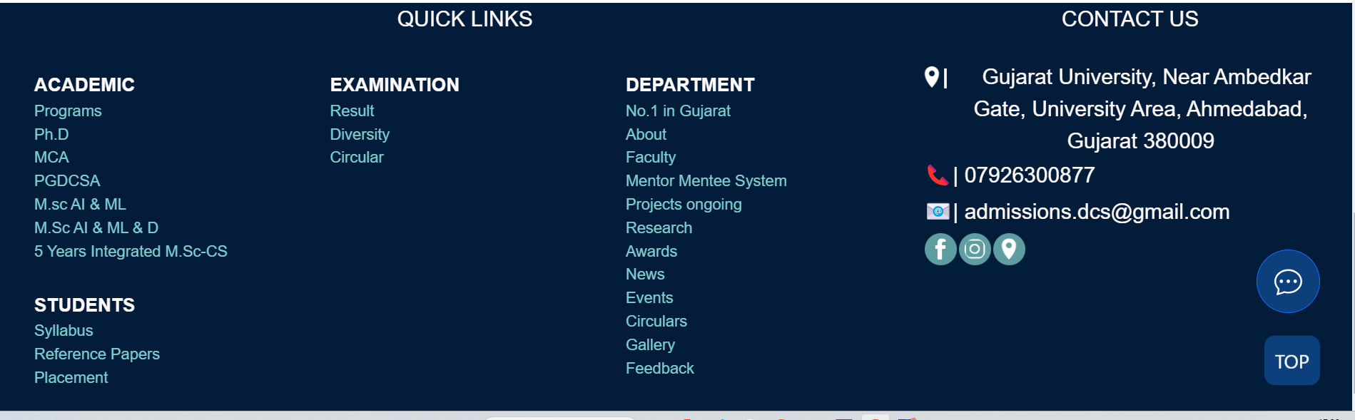
FOOTER

Slide 36

About

Slide 37
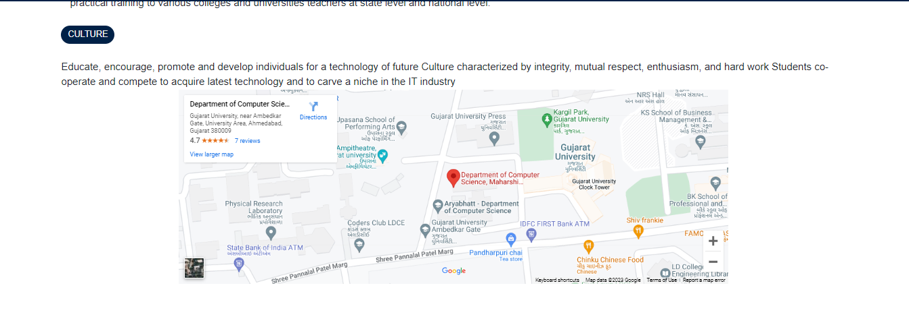
About

Slide 38
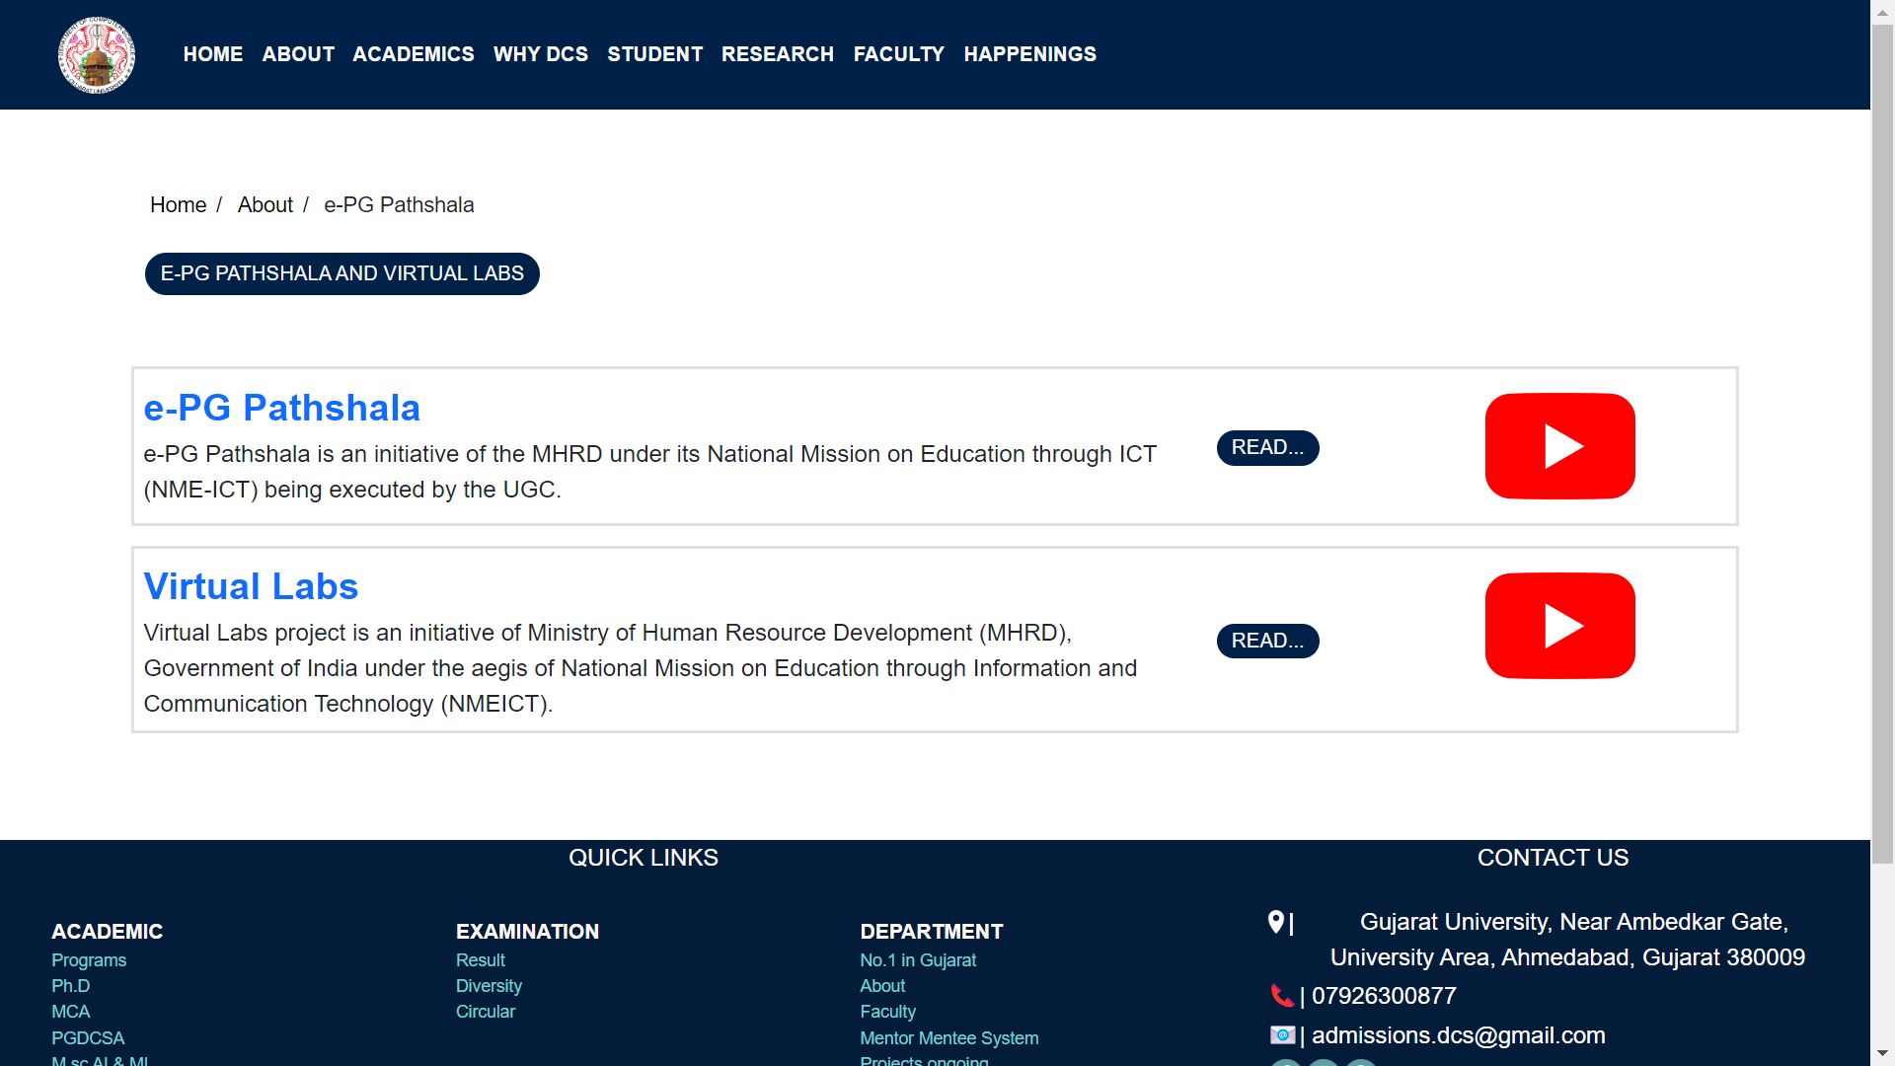
E-PG PATHSHALA

Slide 39
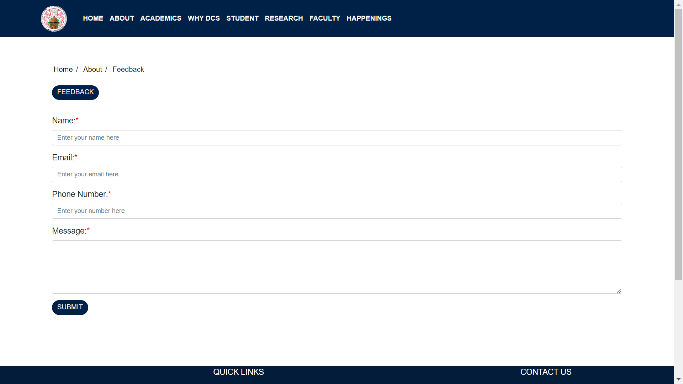
FEEDBACK

Slide 40
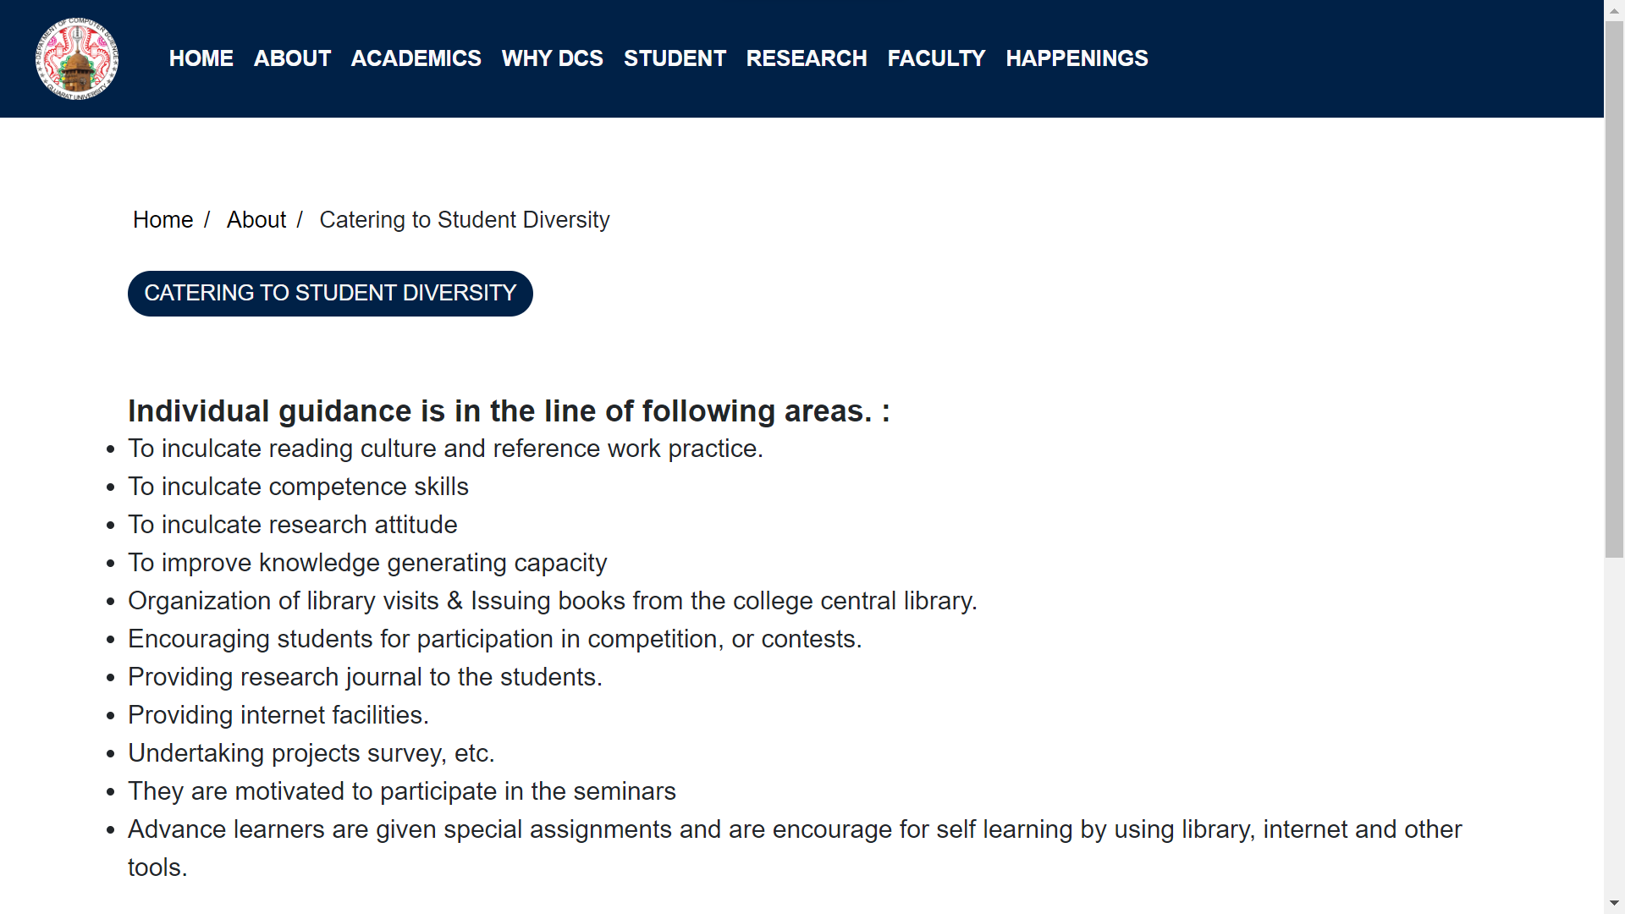
CATERING TO STUDENT DIVERSITY

Slide 41
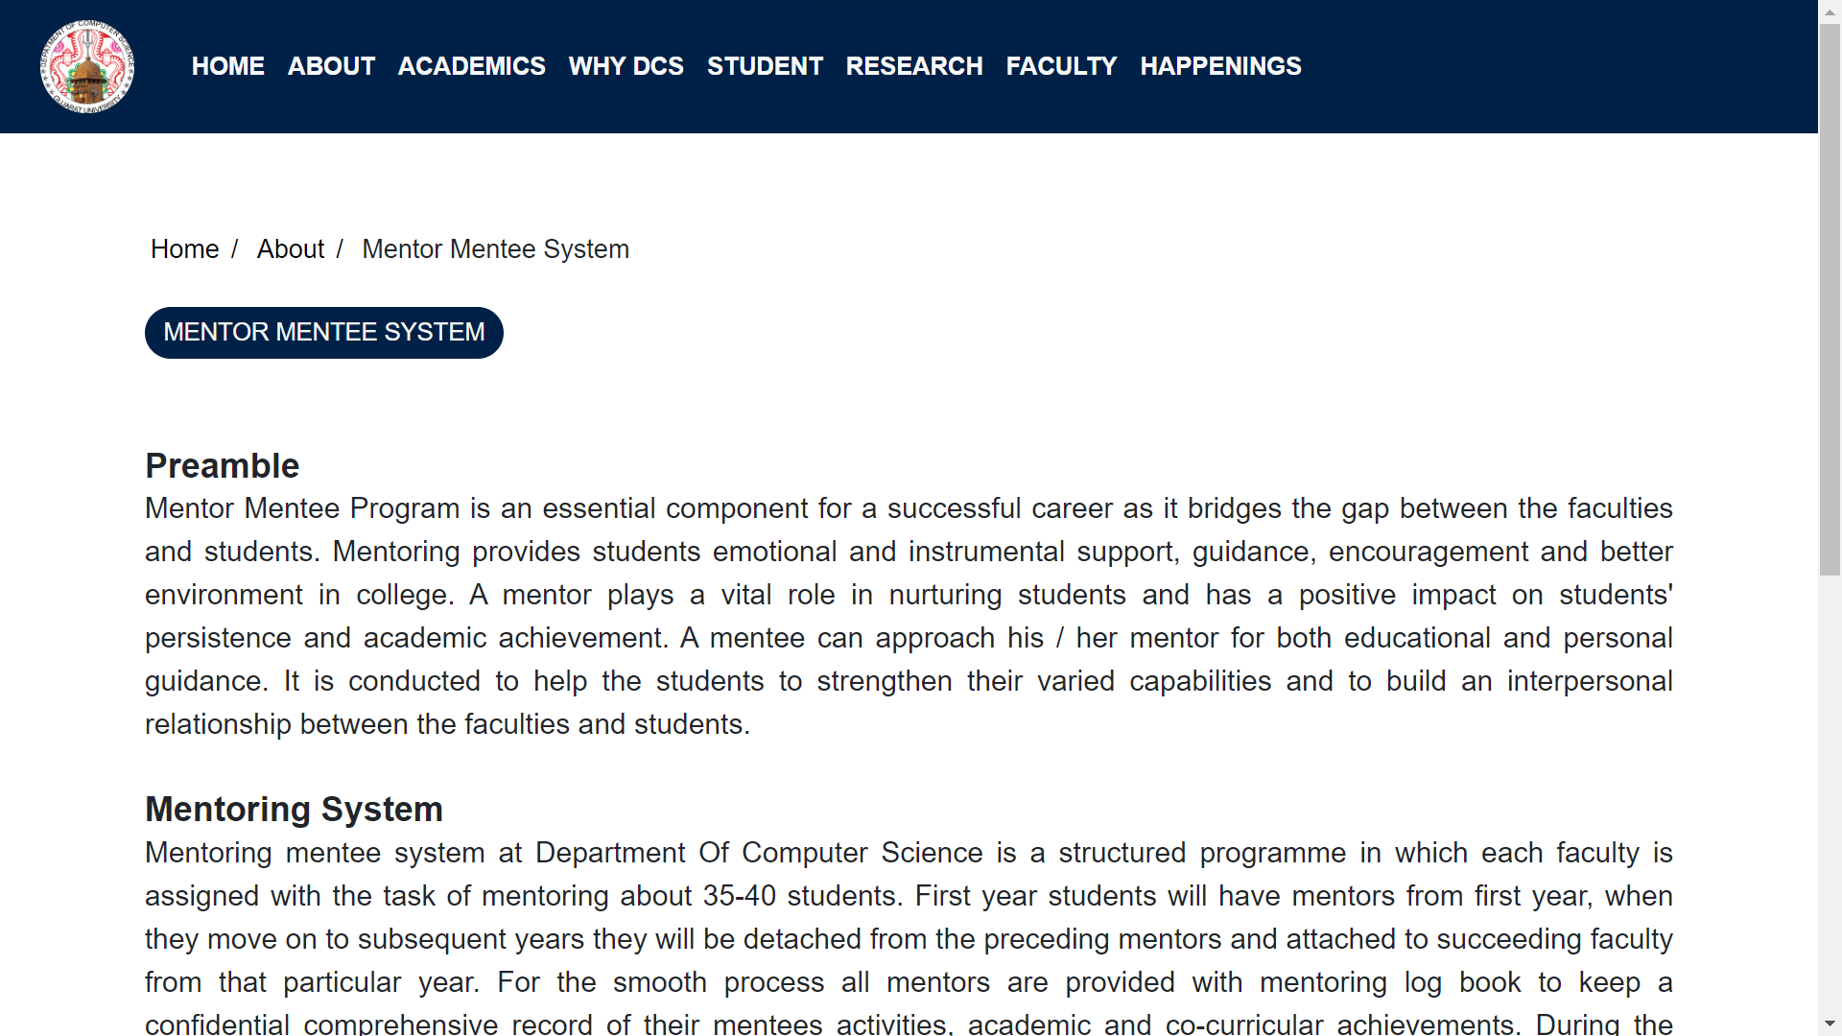
MENTOR MENTEE SYSTEM

Slide 42
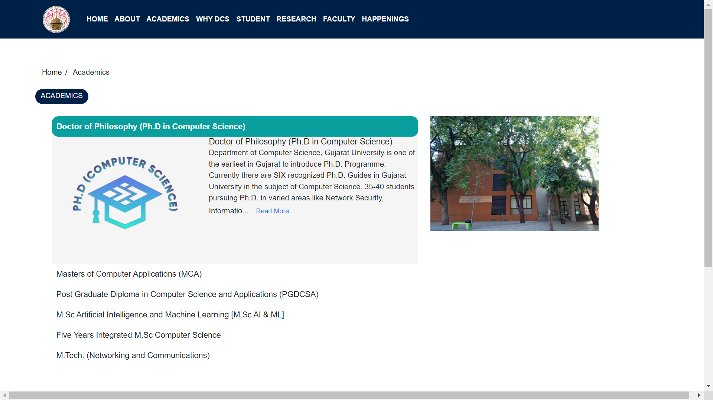
ACADEMICS

Slide 43

ACADEMICS DETAILS

Slide 44
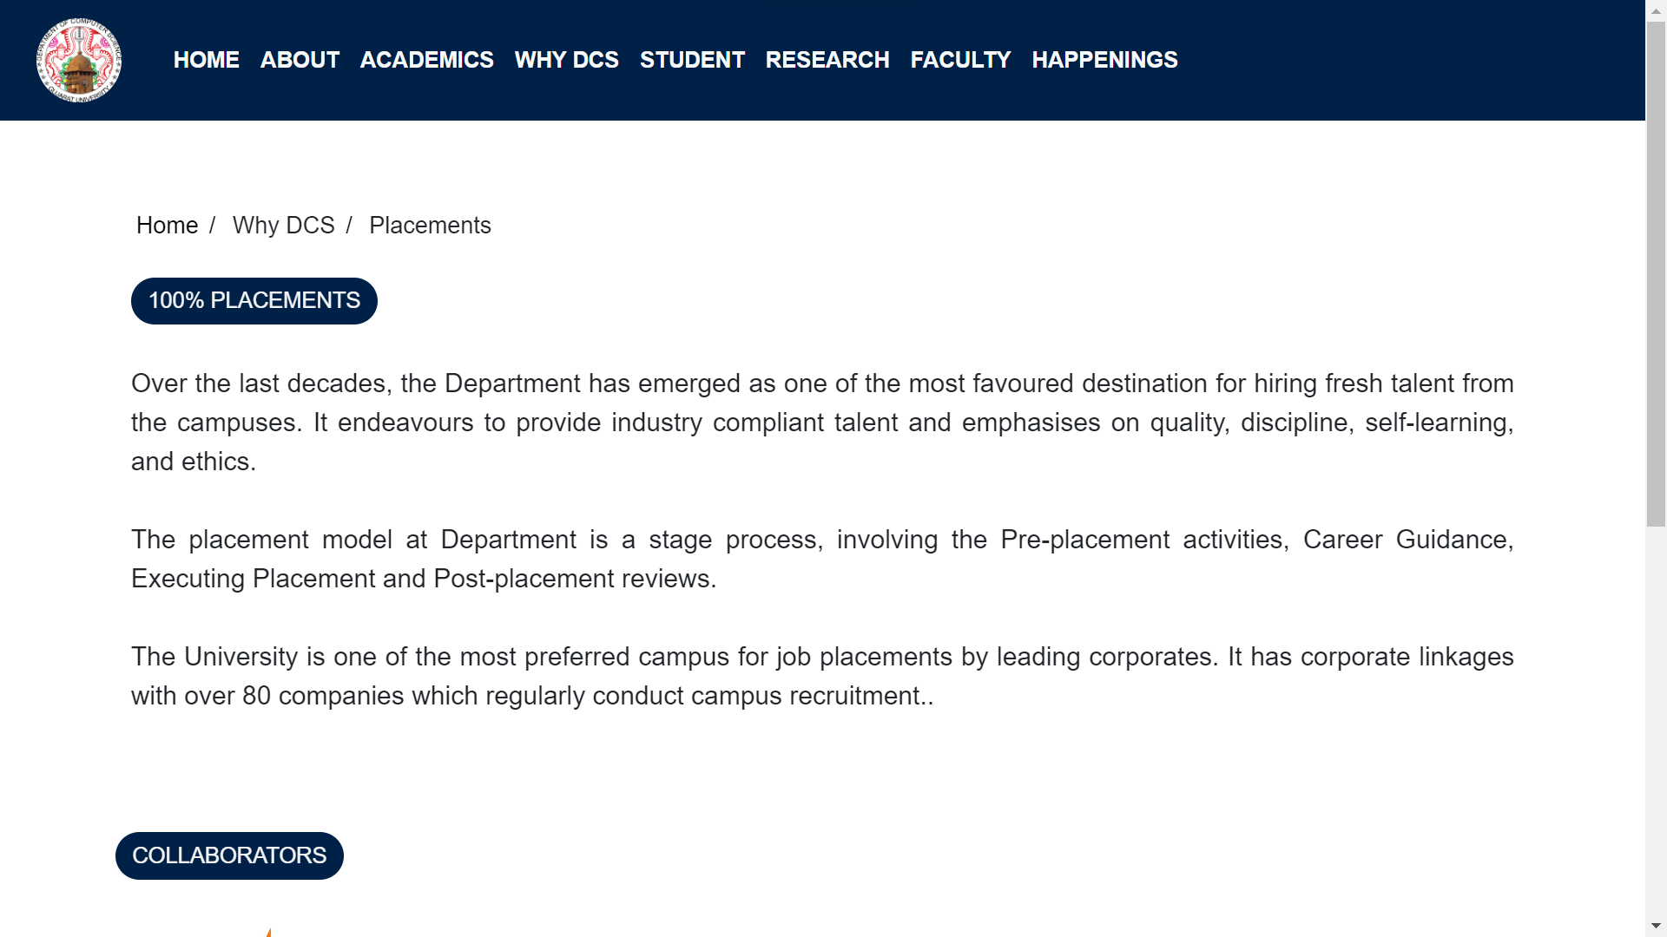
PLACEMENT

Slide 45
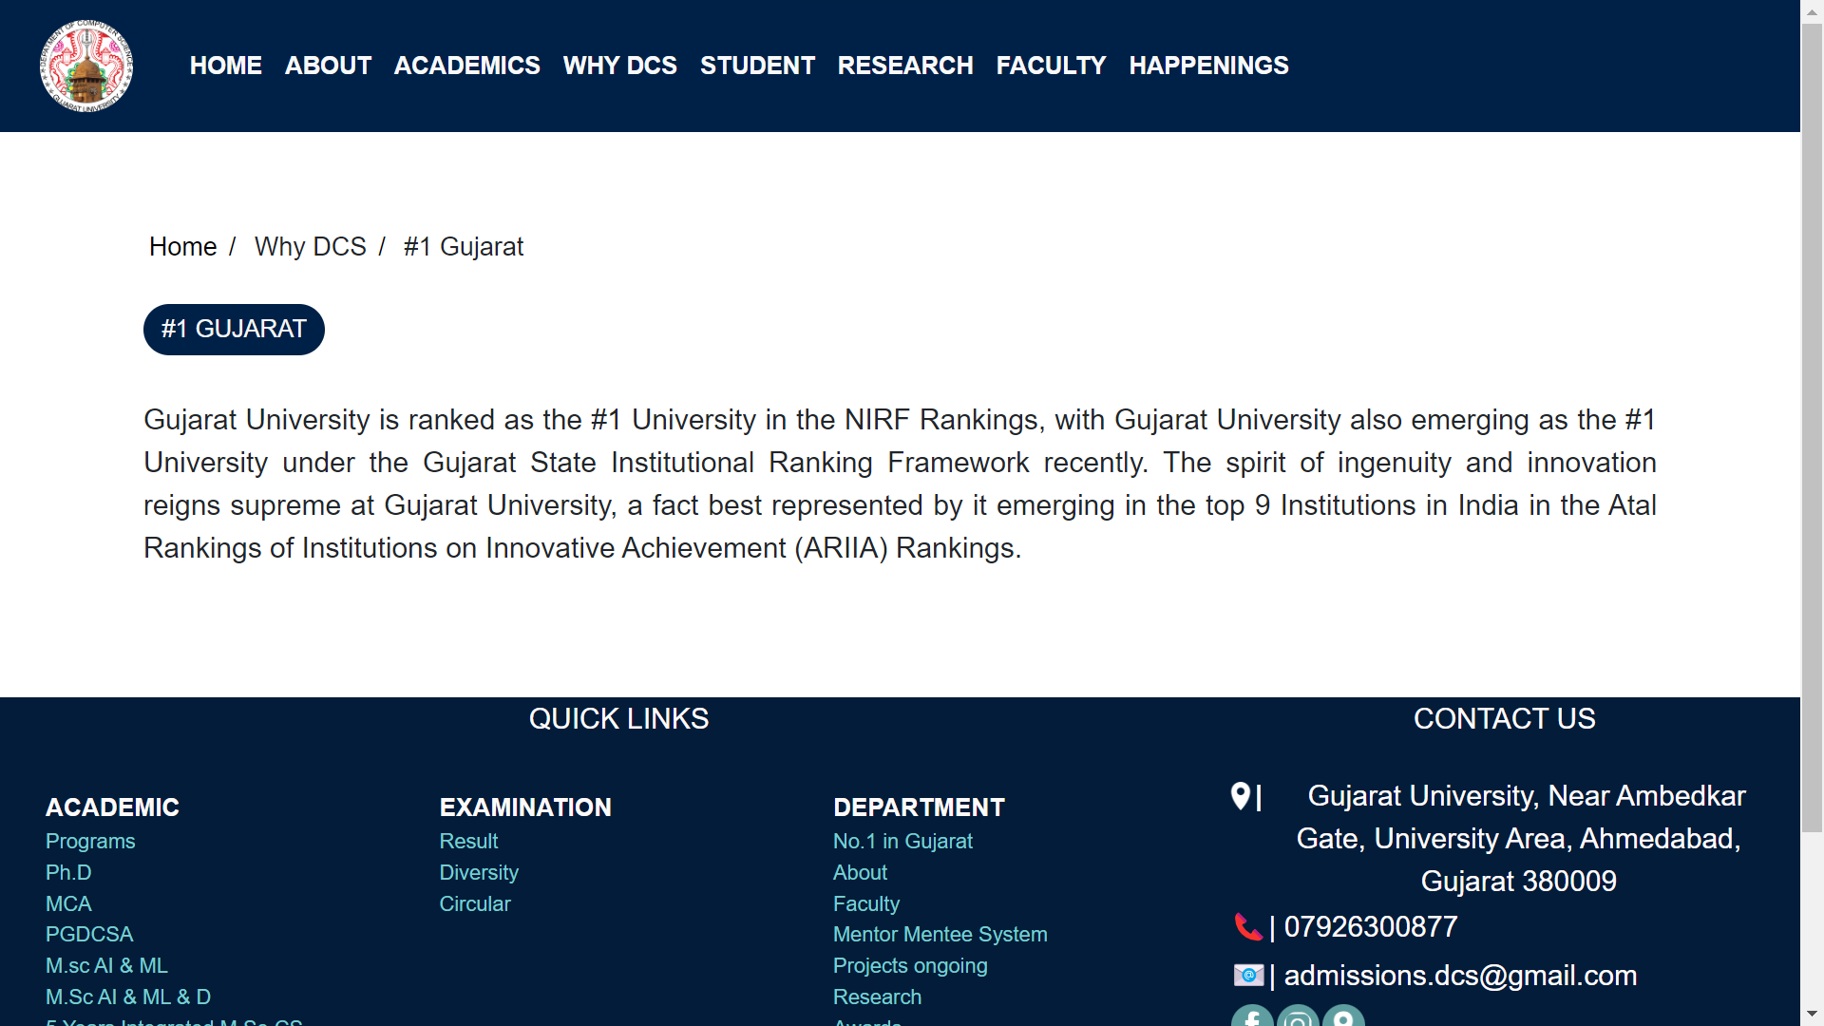
#1 IN GUJARAT

Slide 46
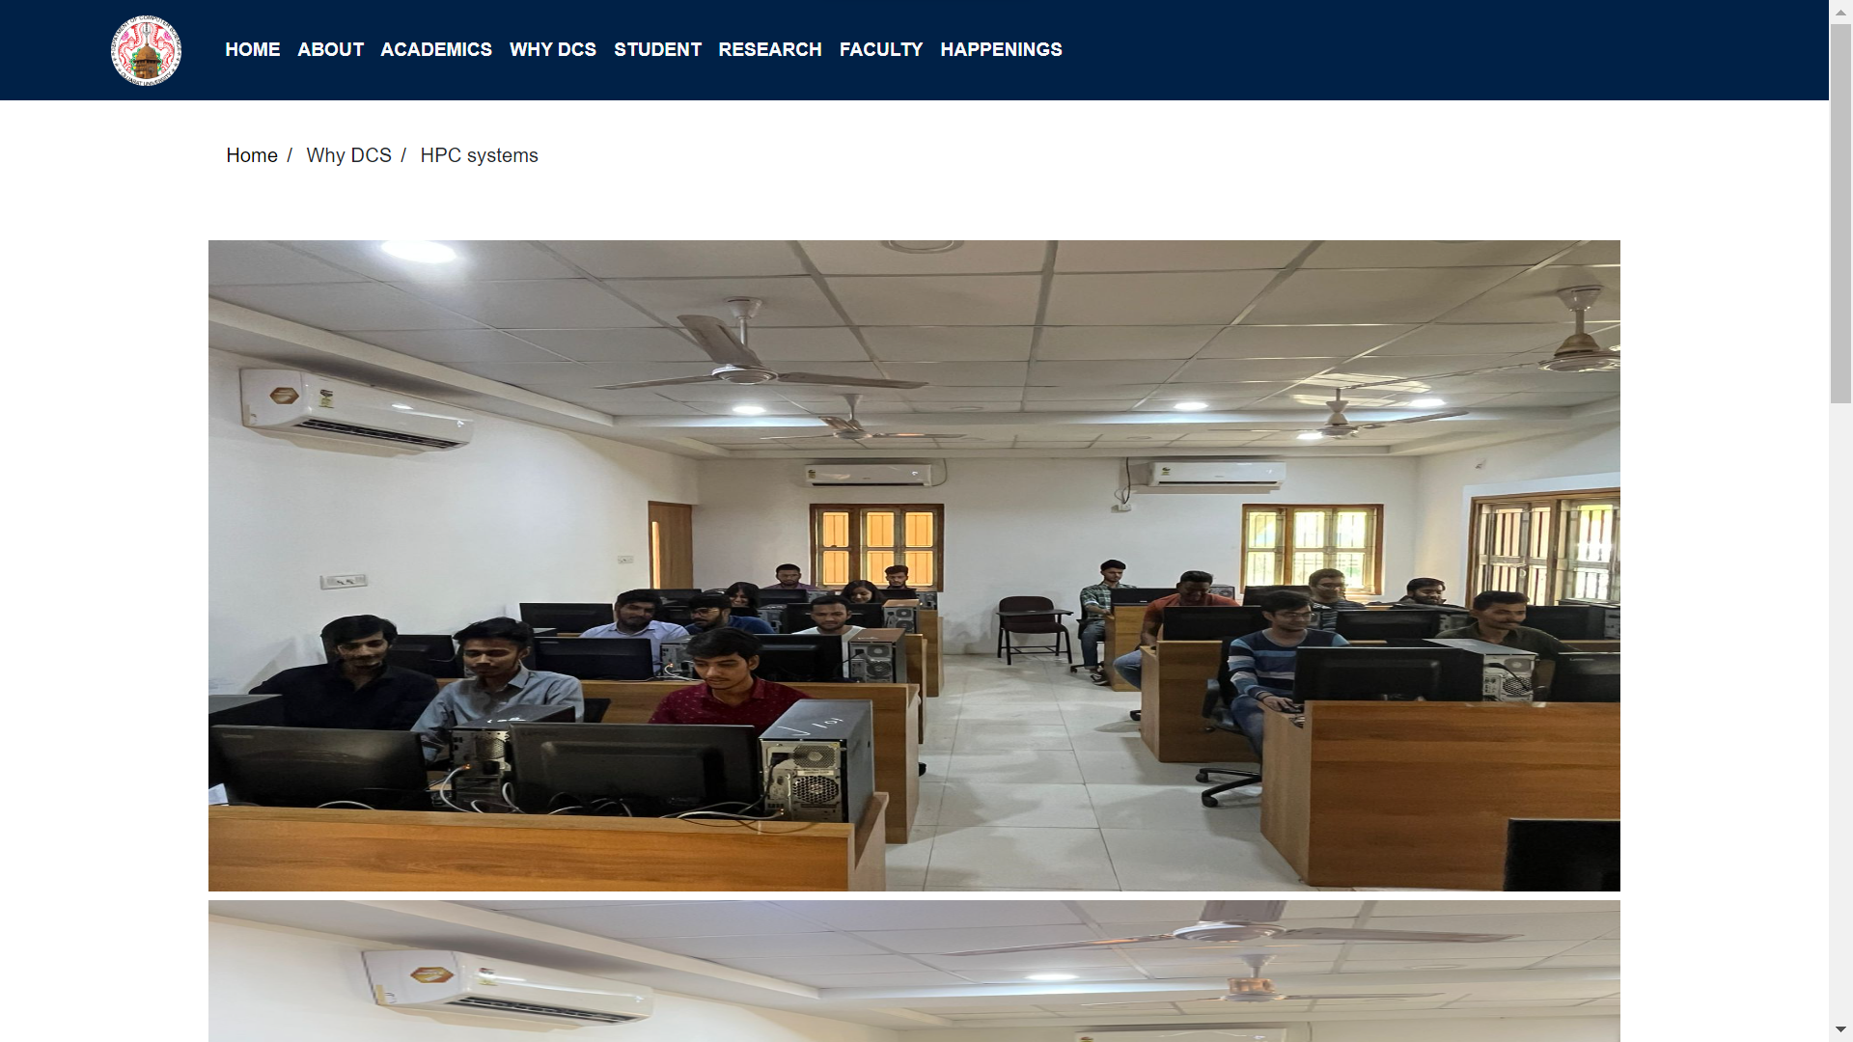
HPC SYSTEMS

Slide 47
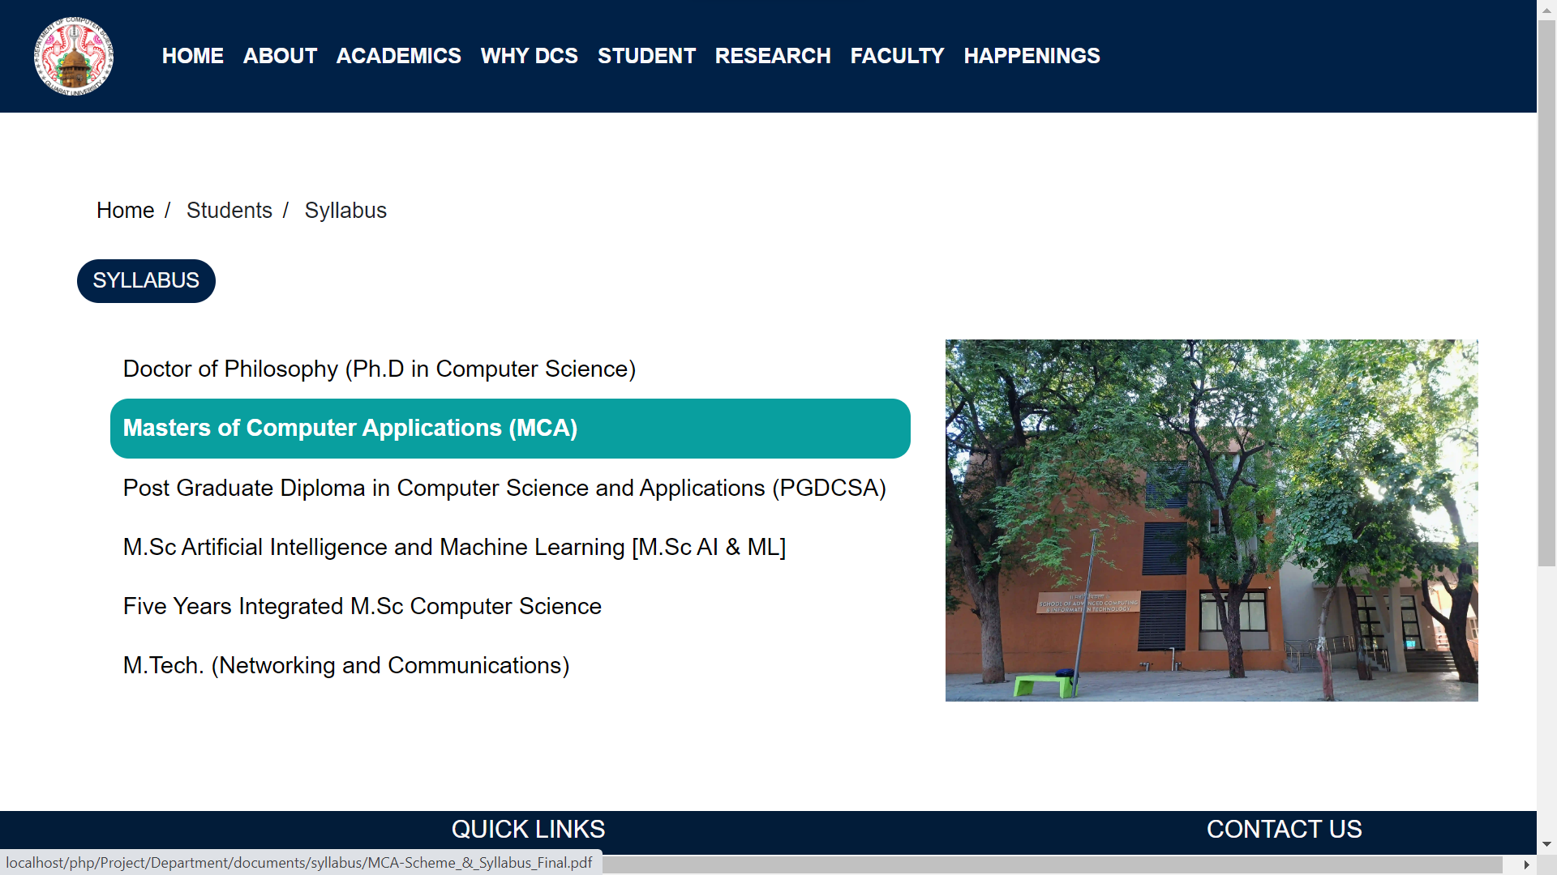
SYLLABUS

Slide 48
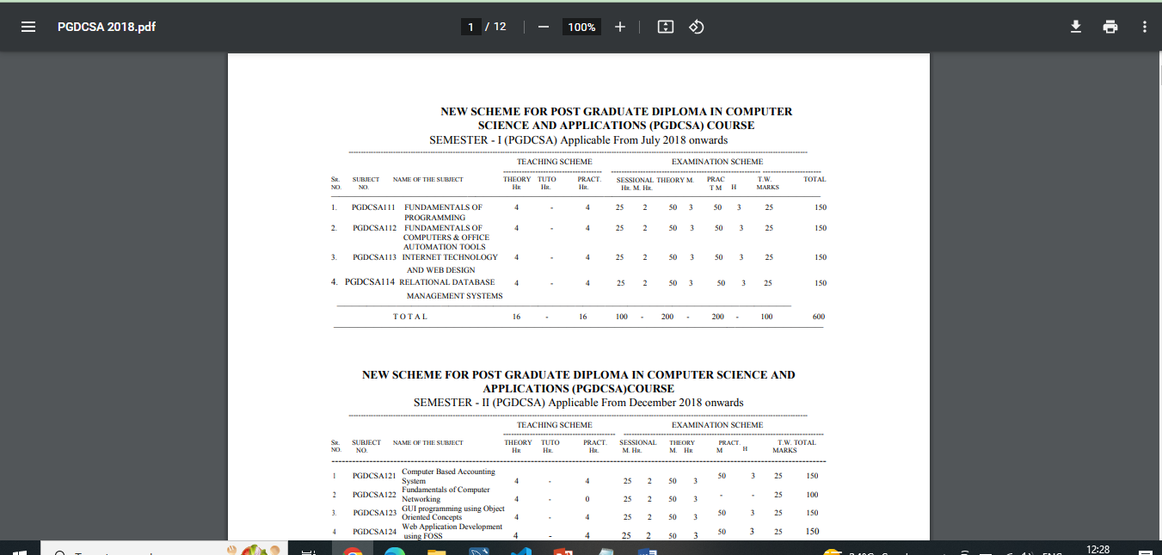
SYLLABUS DOCUMENT

Slide 49
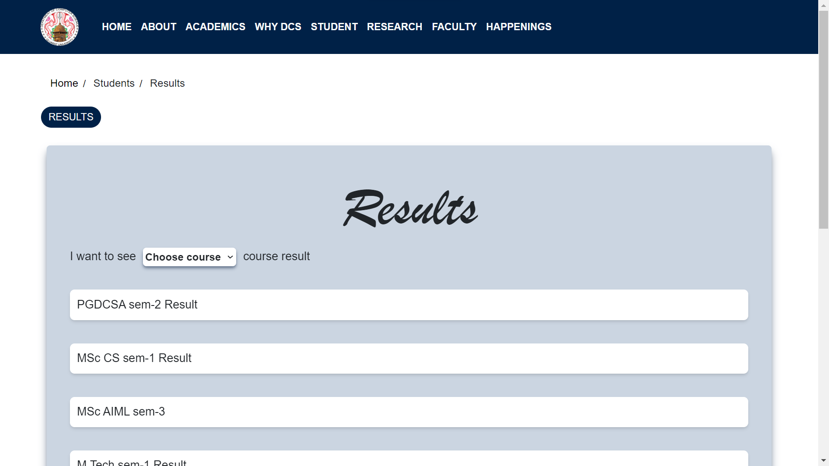
RESULTS

Slide 50
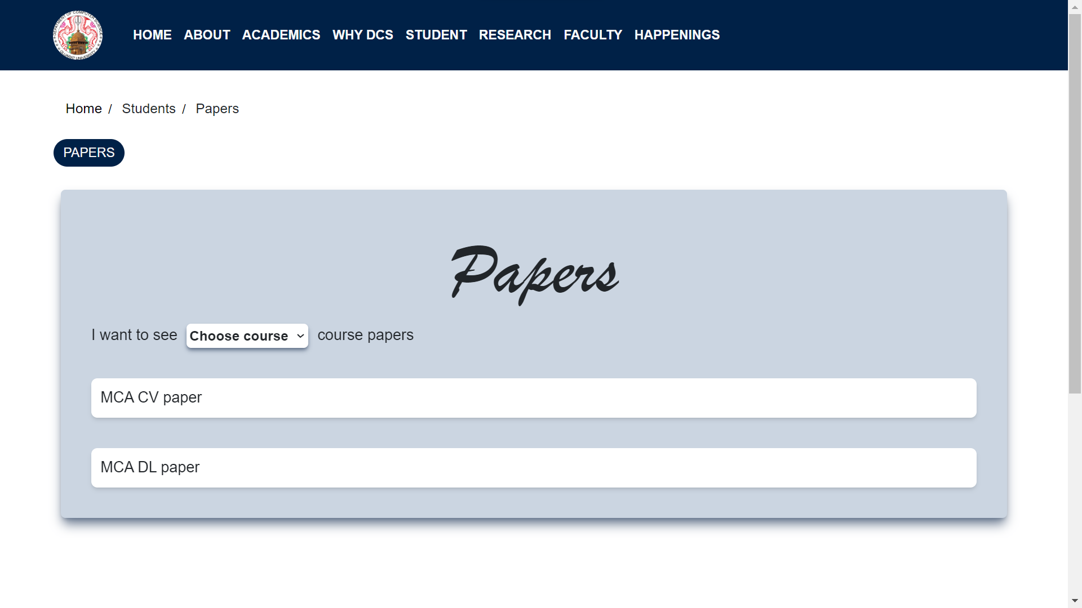
PAPERS

Slide 51
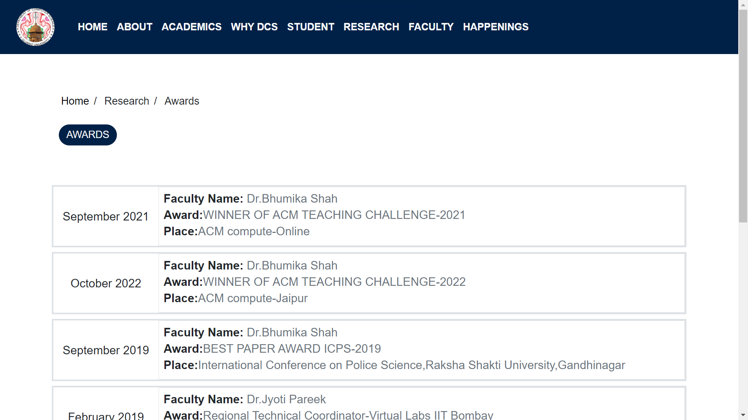
AWARDS

Slide 52
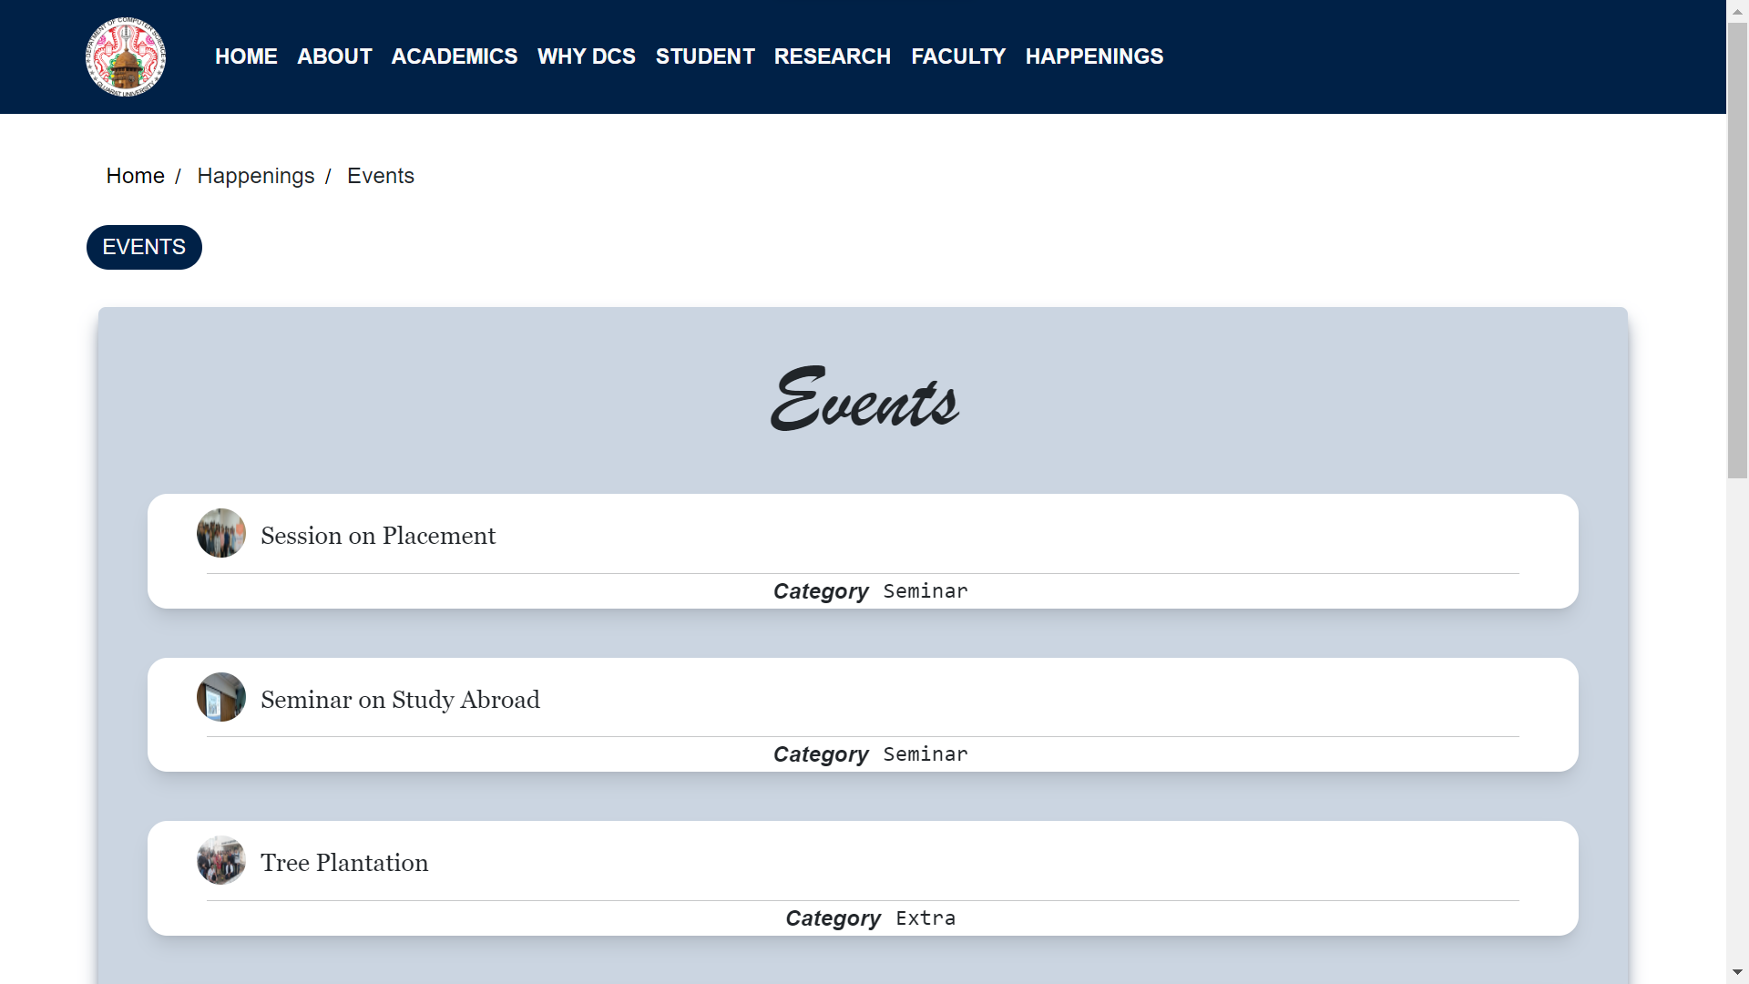
Events

Slide 53
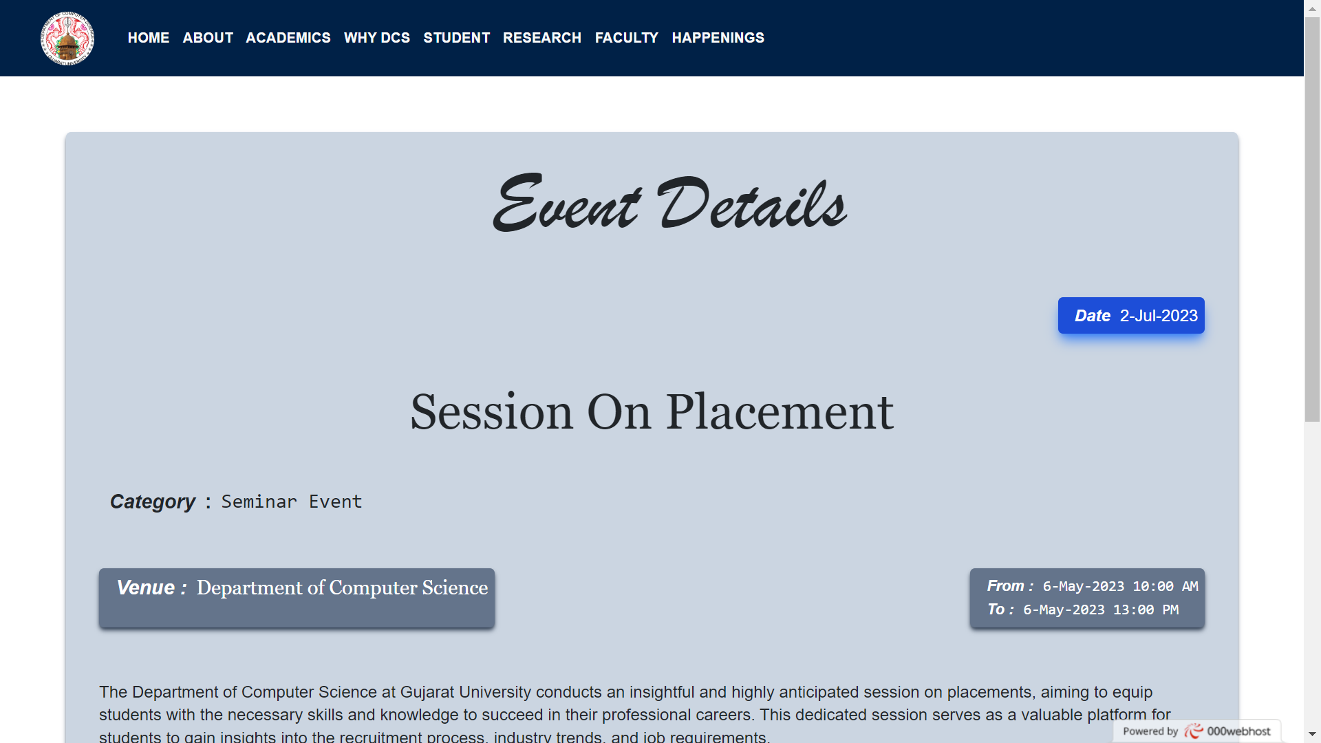
EVENT DETAIL

Slide 54
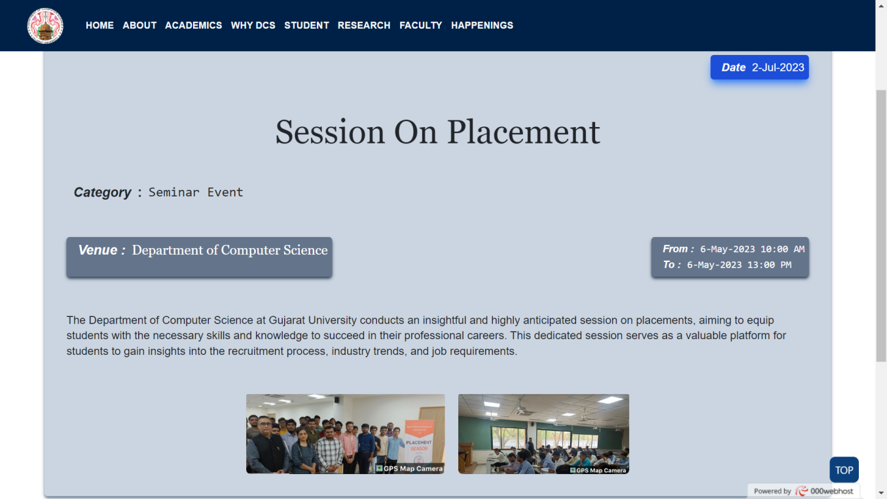
EVENTS

Slide 55
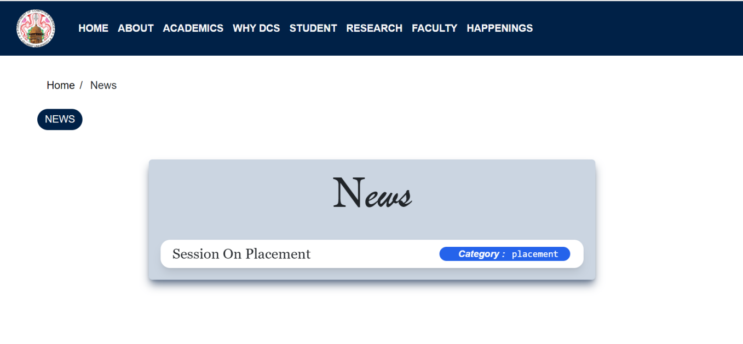
NEWS

Slide 56
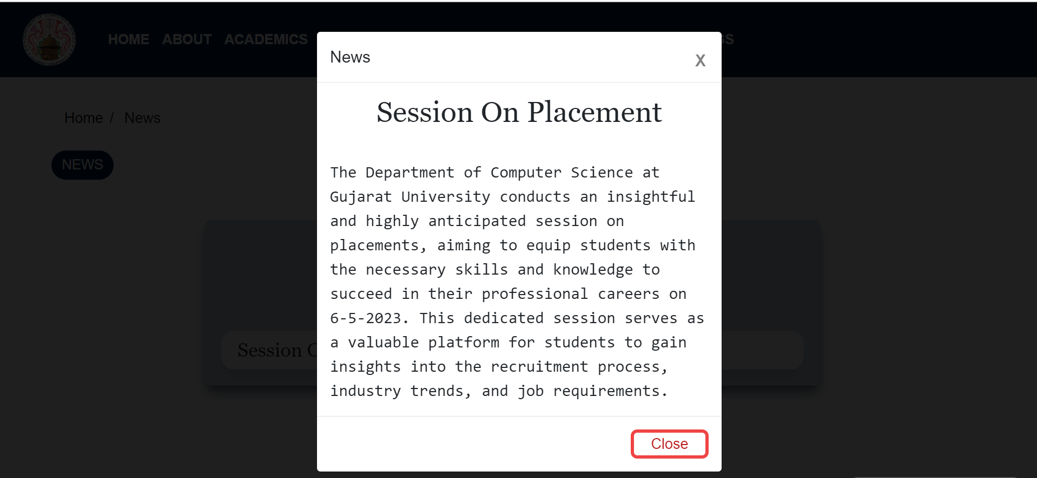
NEWS DETAILS

Slide 57
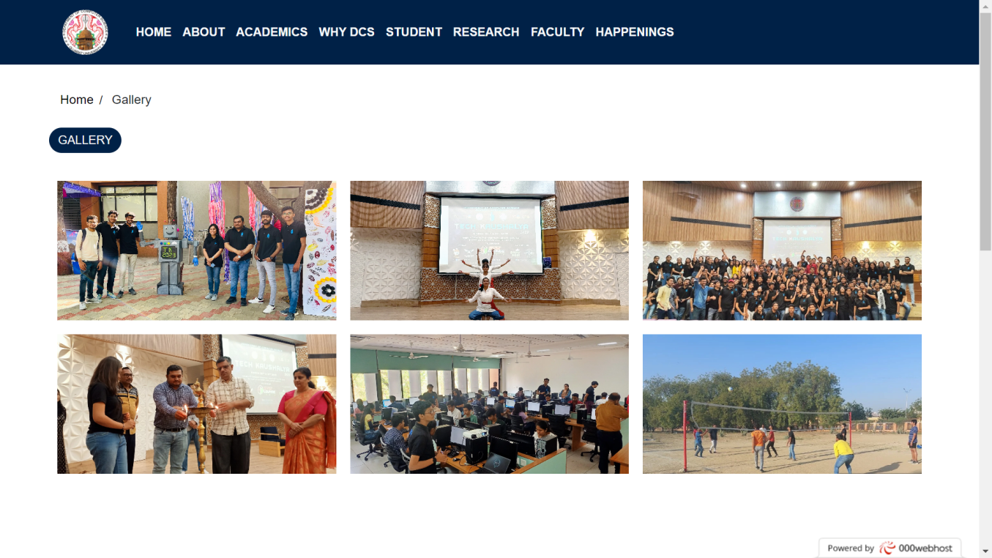
GALLERY

Slide 58
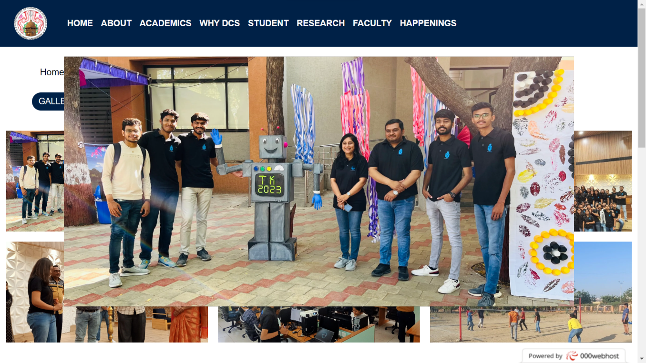
Gallery

Slide 59
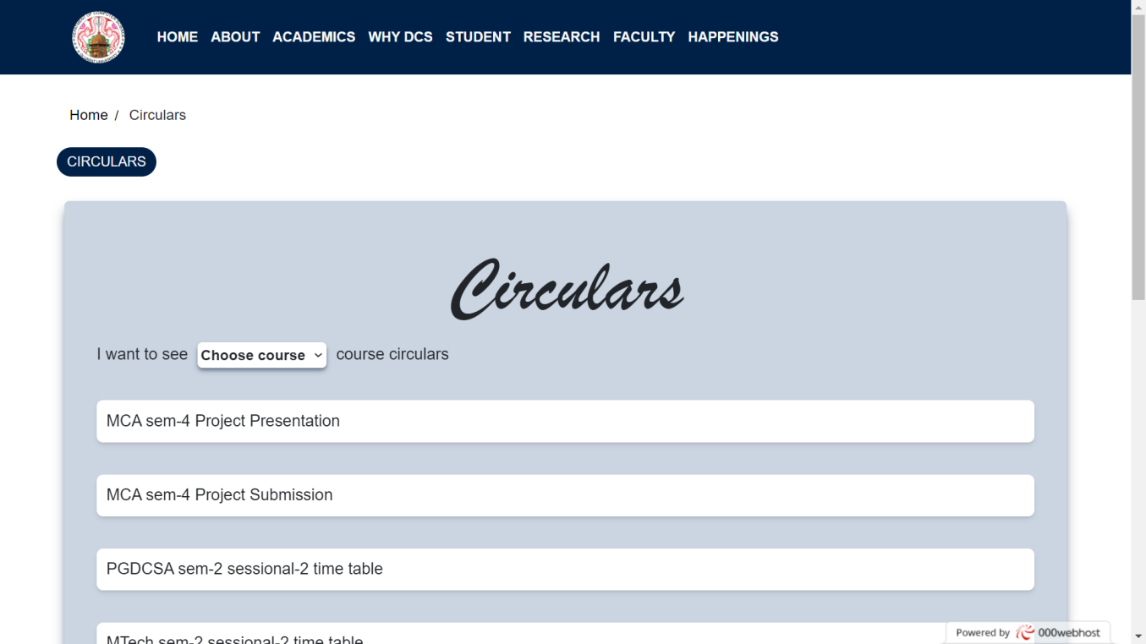
CIRCULARS

Slide 60
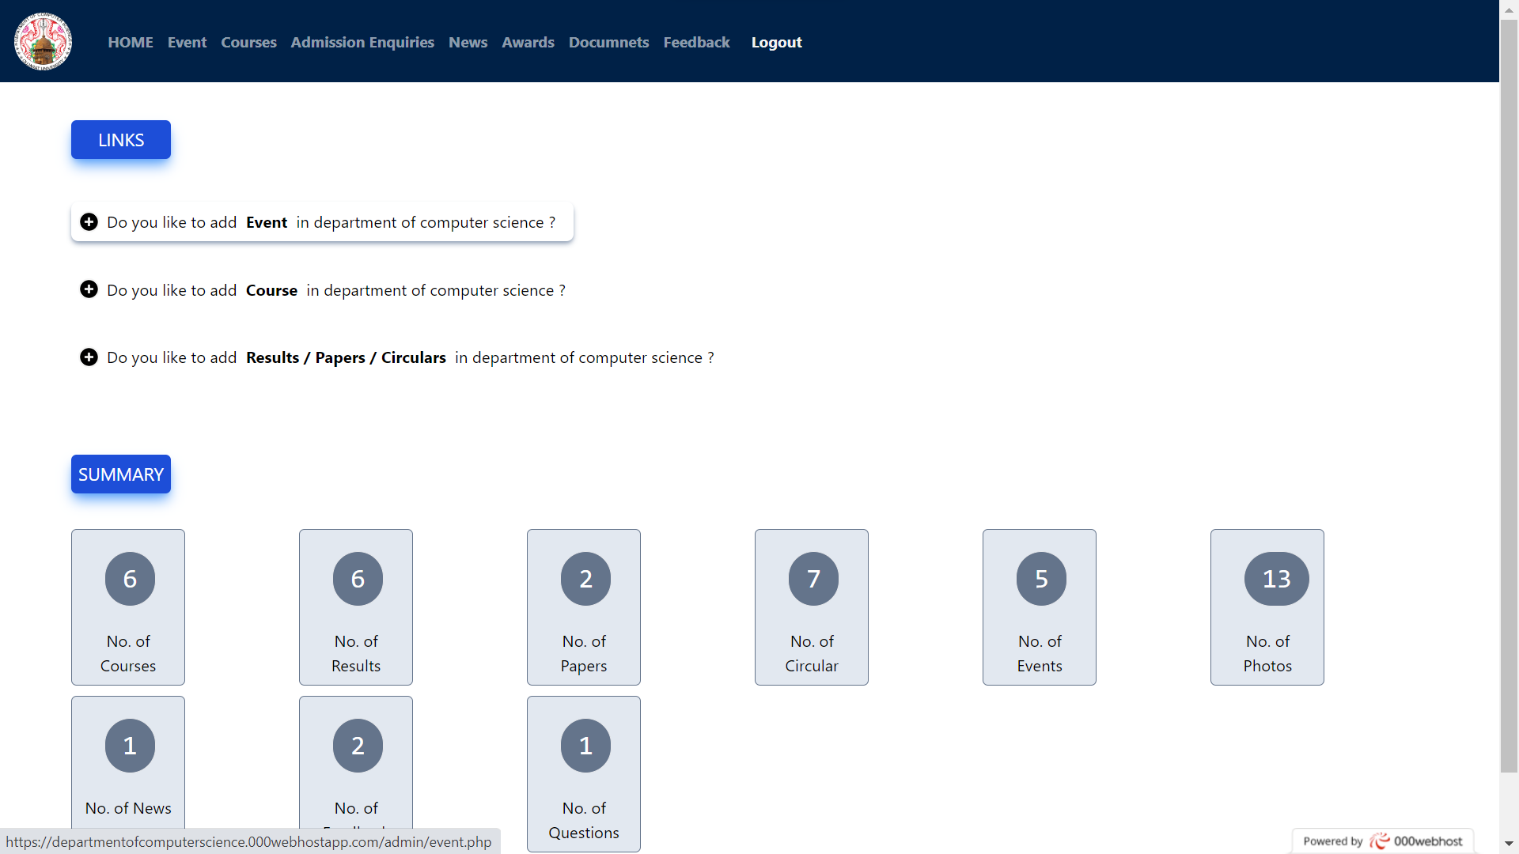
ADMIN HOME PAGE

Slide 61
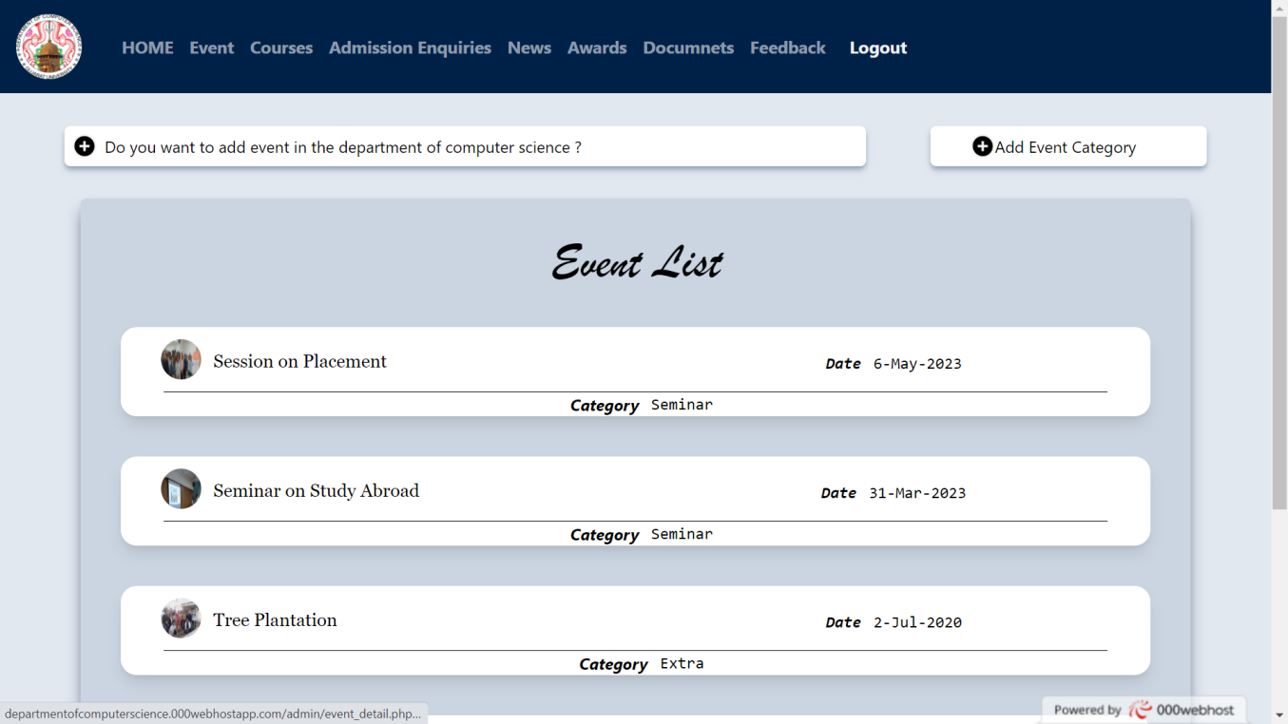
ADD EVENT

Slide 62
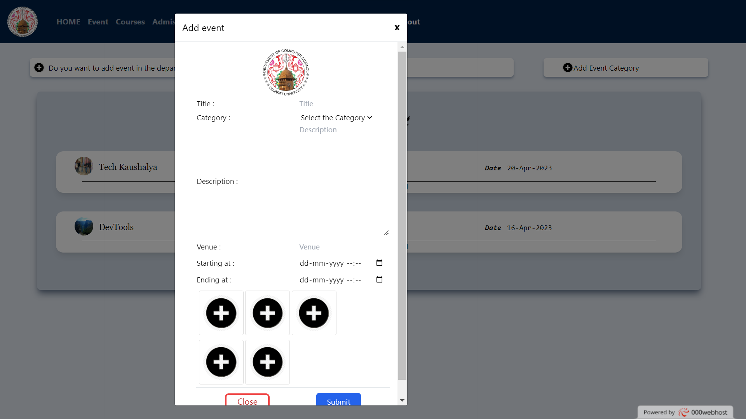
ADD EVENT

Slide 63
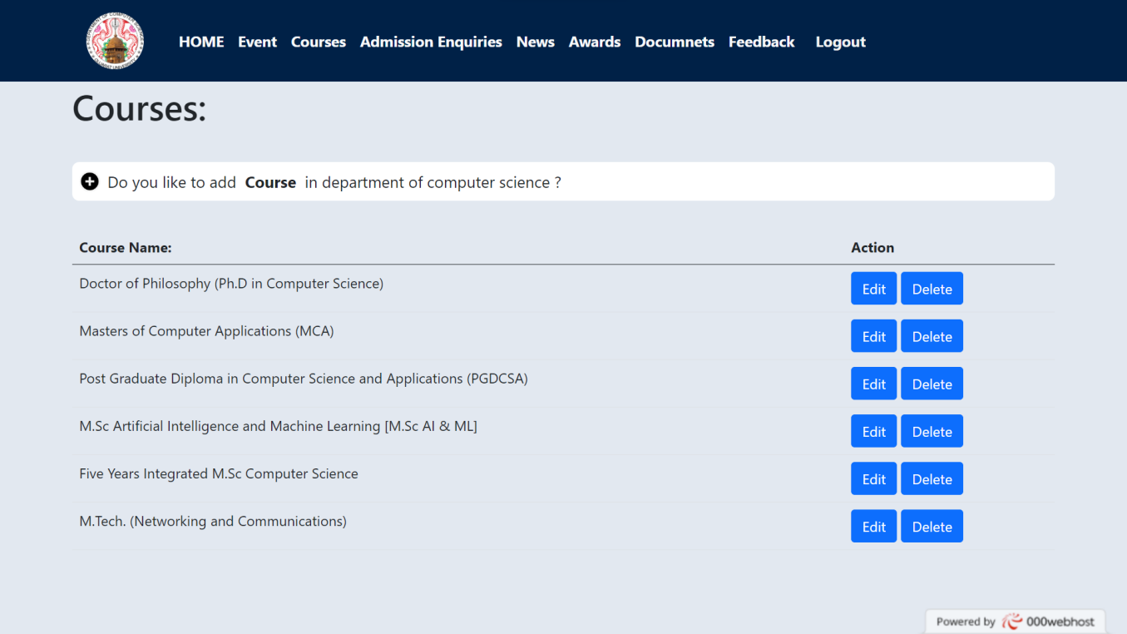
ADD COURSES

Slide 64
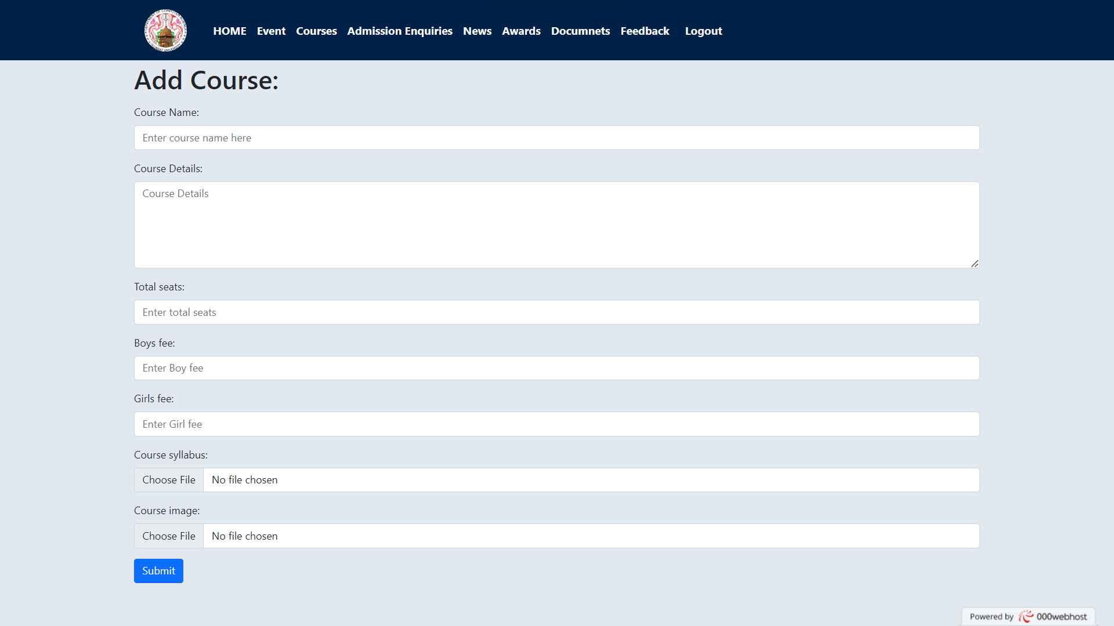
ADD COURSES

Slide 65
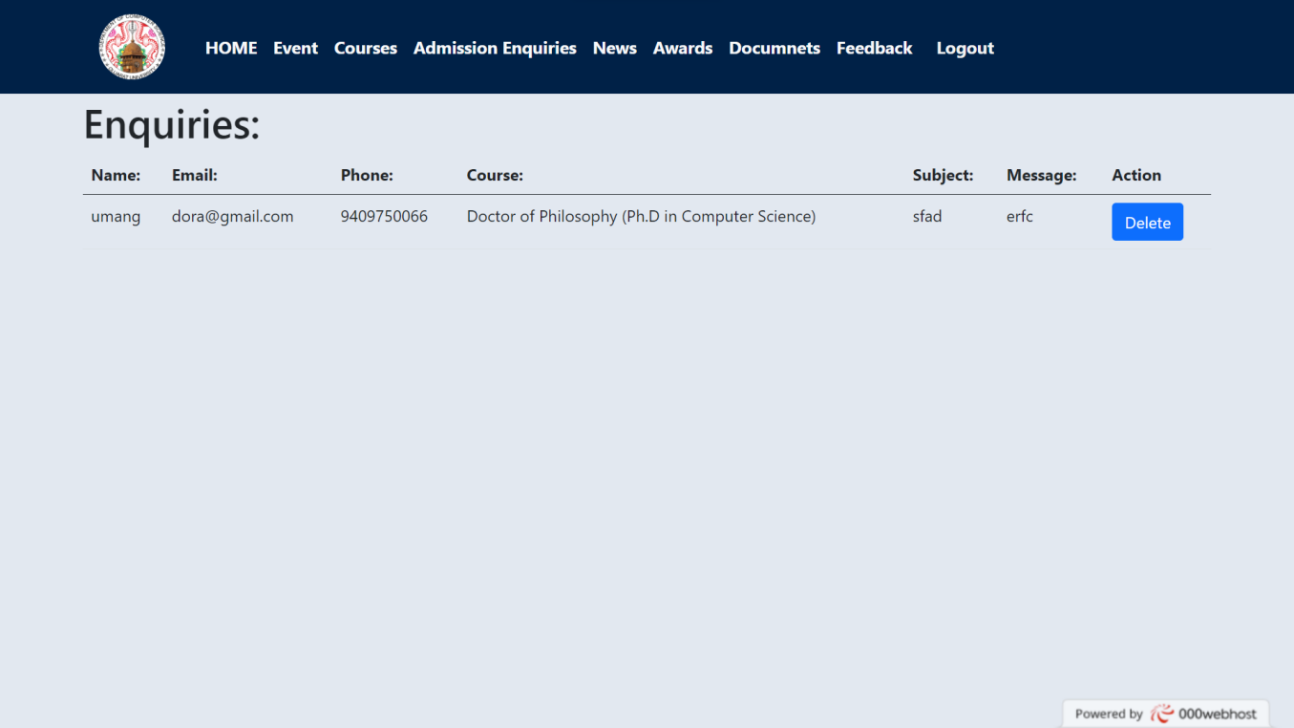
ADMISSION ENQUIRY

Slide 66
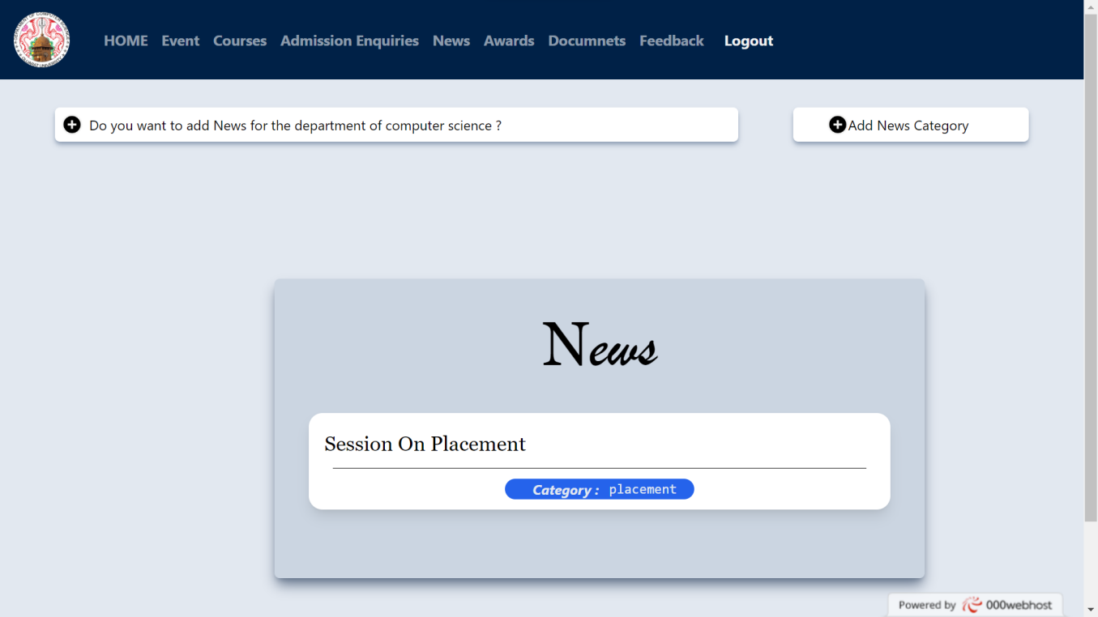
NEWS PAGE

Slide 67
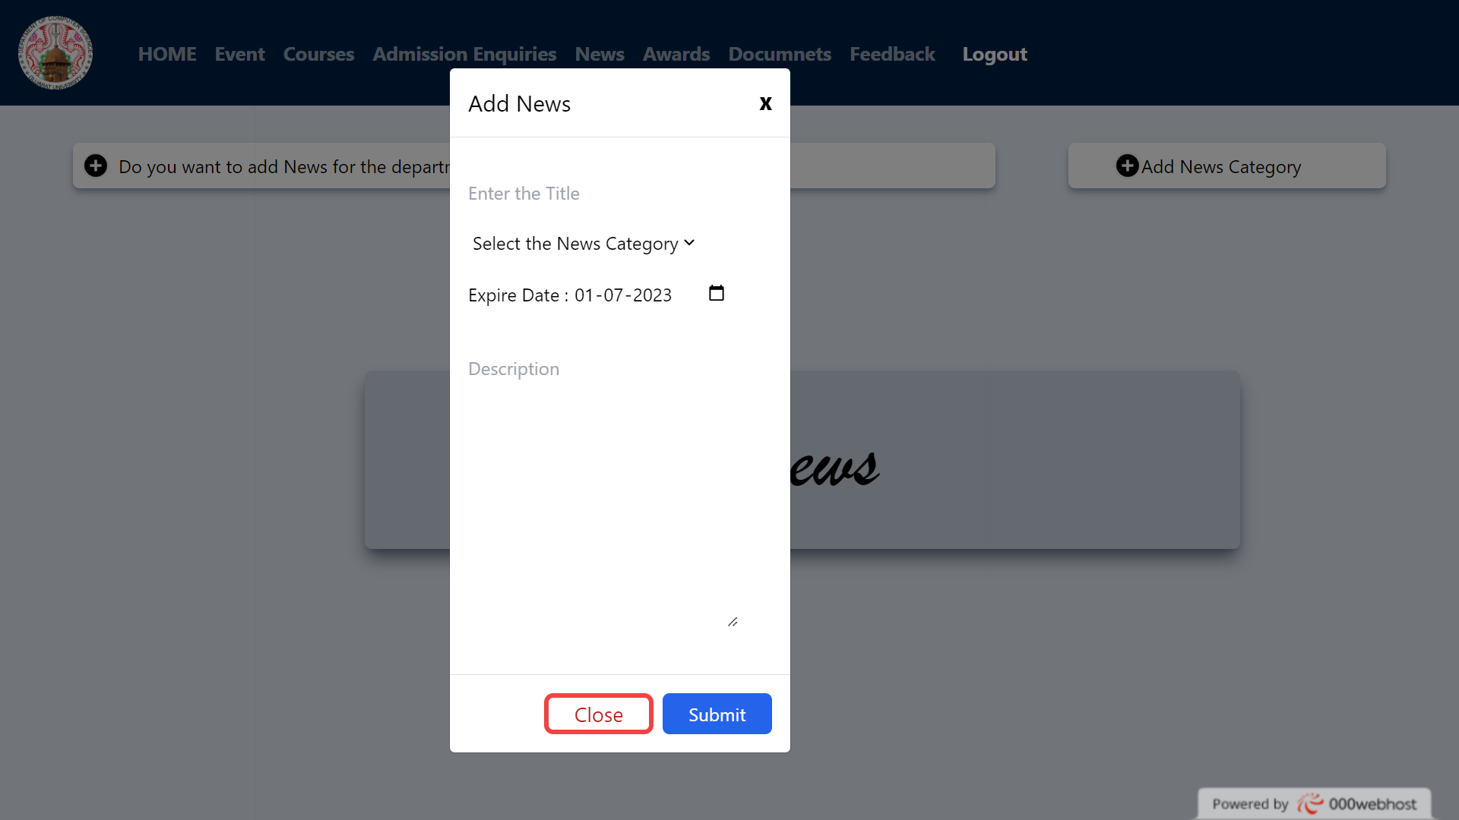
ADD NEWS

Slide 68
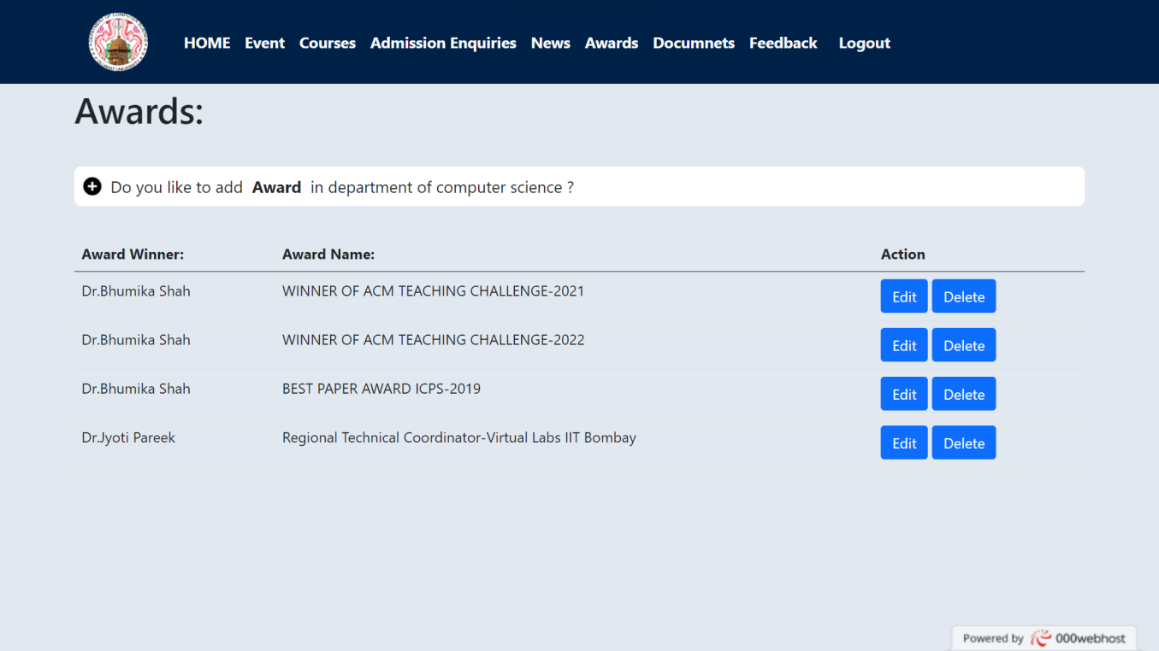
ADD AWARDS

Slide 69
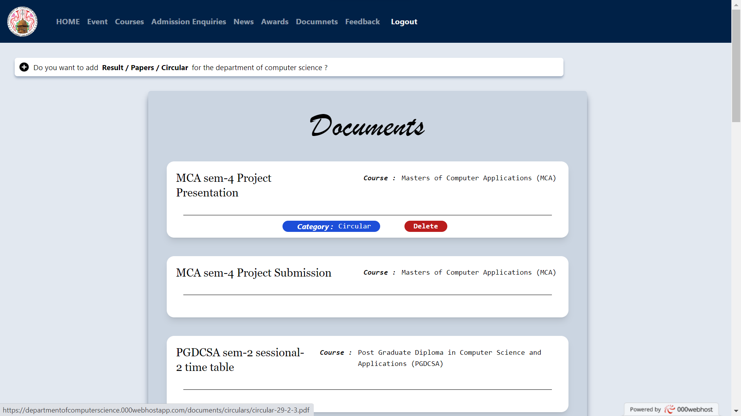
ADD RESULT / PAPER / CIRCULAR

Slide 70
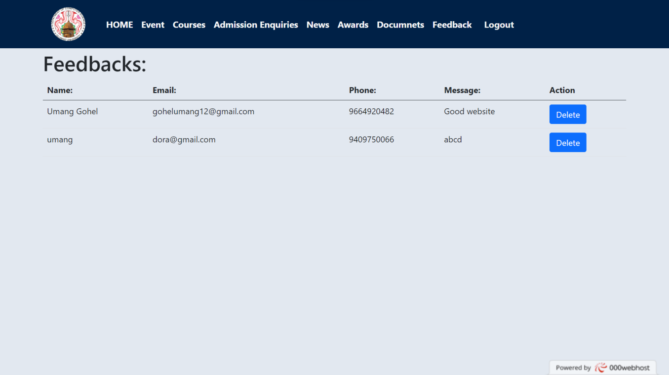
FEEDBACK

Slide 71
Conclusion
Throughout this website, we have showcased our accomplished faculty, and diverse range of programs, highlighting our dedication to fostering intellectual curiosity and professional growth.
Whether you are a prospective student, current student, faculty member, or community member, we encourage you to explore our website further to learn more about our department, its resources, and the valuable opportunities it offers. Should you have any questions or require additional information, our dedicated staff is here to assist you.

Slide 72
Future Work
Integrate placement record year vise
Integrate all faculty details
Integrate Images and other details in 100% placement and #1 in Gujarat pages.
Provide summary in charts about no.of Course, no. of Faculty, no.of Events and no.of Papers etc.

Slide 73
References
Gujarat University
Nirma University

Slide 74
Thank You

